Slide 1

Software Update Reporting - Deep Dive
Bryan Dam
DamGoodAdmin.com
Software Engineer
Recast Software

Slide 2
Bryan Dam
@bdam555
Participation
15 Years
Brewing and Smoking Meats

Slide 3
Agenda
Compliance: What questions are you trying to answer?
Existing update reports: built-in, community, and partners
Where's the data for software updates?
What does any of this actually mean?
What can we do with it?

Slide 4
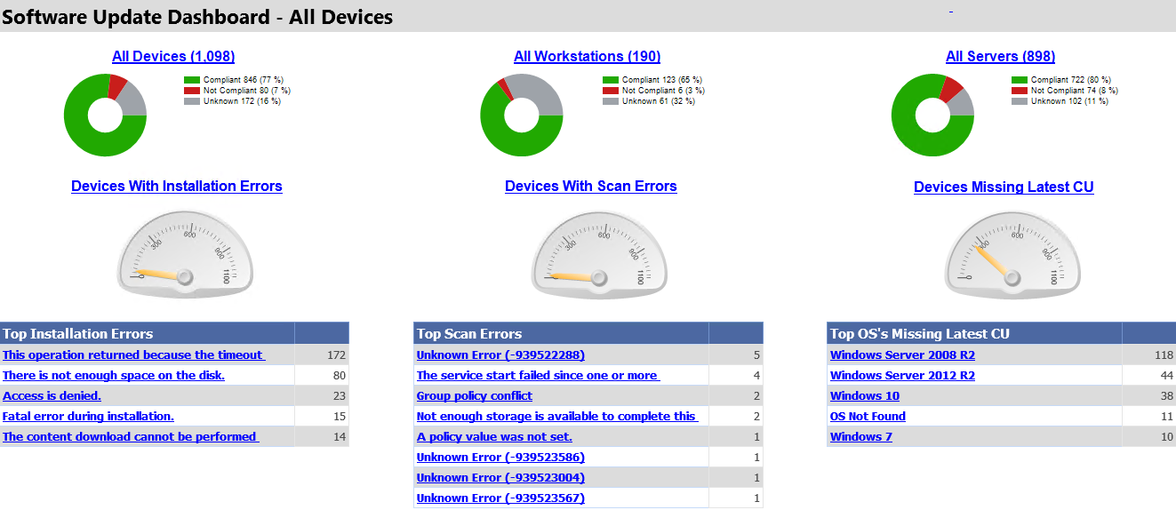
Here’s what we’re working up to

Slide 5
Defining compliance
Why we can’t have nice things

Slide 6
DEFINING COMPLIANCE – Update Selection
Deployment status and age
Update Categories
Software Update Groups
What standards/SLAs do you need to meet?
  Aka, all Security SU must be deployed within 14 days of release!
Notes:
Examples of definitions that we’ve seen:
Last month’s patches were installed.
Security and Critical Updates are installed.
All applicable patches are installed.
All applicable deployed patches are installed within 14 day of their deadline.
SLA/MW:
Servers: yearly reboots makes 30 days impossible.
Workstations: long-running processes/queries can’t be interrupted.

Slide 7
DEFINING COMPLIANCE – Device selection
Server vs Workstation
Operating Systems
SLA and Maintenance Windows (ex. Manually patched)
What is an ‘Active’ device
Notes:
Device Scope: How do you handle inactive or decommissioned clients?
Update Scope: What update Classification/Categories/Products/Language are you syncing? You can only report on updates ConfigMgr knows about.
Poll: What compliance percentage do people think is reasonable? 50, 70, 90 … any poor smucks trying to hit 100?
These are not one-time discussions, you need to review with management regularly.

Slide 8
Existing solutions
Before You Go Off and Reinvent the Wheel

Slide 9
Ask yourself: is this really worth it?
The skills involved are not trivial
  Writing SQL is hard. Writing great SQL can be maddening
  Making the data look good takes an eye for design
  You need to be a subject matter expert
It always takes 20x as long as you think it will!
Your time really does equal money!

Slide 10
Built In reports
Software Updates – A Compliance
  Compliance 5 - Specific computer
  Compliance 6 - Specific software update states (secondary)
Software Updates – B Deployment Management
  Management 2 - Updates required but not deployed
  Management 7 - Updates in a deployment missing content
Software Updates - C Deployment States
  Detailed information regarding individual deployments.
Software Updates - D Scan
  Scan states by collection/site
Software Updates - E Troubleshooting
  Troubleshooting 1 - Scan errors
A beautiful looking dashboard in /Monitoring/Security/Software Update Dashboard that had no details available beneath it.

Slide 11
Community Solutions
Garry Simmons: Software Update Compliance Dashboard
  Patch My PC Package: Free Software Update Compliance Dashboard Reports for Microsoft SCCM
Software Update Groups Compliance Dashboard Revisited
SCConfigMgr: Patch Compliance Reporting in Configuration Manager with PowerBI
Bryan Dam: Software Update Dashboard
Microsoft: Configuration Manager PowerBI Template

Slide 12
Vendor Solutions
Recast Software: Endpoint Insights
CTGlobal: Insight Analytics
System Center Dudes: Software Update Reports
Fat Stacks: BI for SCCM

Slide 13
Show me the data
All About That Database

Slide 14
Where is the Docs?
The documentation for SCCM’s views exists but is frustratingly vague (but getting better)
  Software updates views in Configuration Manager

Slide 15
UPDATE Views: Terminology
Each state has its own three digit State/Topic Type described in v_StateNames
Compliance
  Are required/needed updates installed?
  State Type 300 for assignments/deployments and 500 for updates.
Enforcement
  The state of the installation effort.
  State Type 301 for assignments/deployments and 402 for updates.
Evaluation
  The state of the last deployment compliance evaluation.
  State Type 302 for assignments/deployments.
Scan
  State type 501 for software update scans.

Slide 16
V_StateName
--Compliance: Are required/needed updates installed?
--Deployments
Select * from v_StateNames Where TopicType=300
--Updates
Select * from v_StateNames Where TopicType=500
--Enforcement: The state of the installation effort.
--Deployments
Select * from v_StateNames Where TopicType=301
--Updates
Select * from v_StateNames Where TopicType=402
--Evaluation: The state of the last deployment compliance evaluation
Select * from v_StateNames Where TopicType=302
--Update Scans
Select * from v_StateNames Where TopicType=501
Notes:
This is the basis for creating reports on the updates you just deployed and allows you to create subscriptions for specific ADRs

Slide 17
Show me the Views!
There are 4 important areas for SU:
  Summary Views
  Deployment Views
  Software Update Detail Views
  Views you want to join to
What about Role Based Administration (RBA)?

Slide 18
Top 3 Summary Views
View Name | Description
v_Update_ComplianceSummary | Count of devices by Status for each Update and Update Group
v_CIAssignmentSummary | Count of devices by Status for each Deployment
v_UpdateSummaryPerCollection | Count of devices by Status for every Collection in your environment for each deployed update.
v_Update_ComplianceSummary
  Per update: join where v_UpdateInfo.CITYpe_ID = 8
  Per Software Update Group: join where v_UpdateInfo.CITYpe_ID = 9
Pros: Fast and easy to use
Cons: Laggy and rarely match their lower-level details
Notes:
Fields shown in each: Total, Unknown, Not Applicable, Missing, Present, Installed, Failed
v_Update_ComplianceSummary
v_UpdateSummaryPerCollection
Because it’s _every_ collection it’s a good source when reporting by arbitrary collections.
Laggy: Summaries are created by background processes meaning that the data is not real-time
Matching lower levels: If you drill down into details from the summary your boss will forever ask you to explain the differences

Slide 19
Update Views: STATUS SUMMARIZER VIEWS
v_AssignmentEnforcementSummaryPerUpdateAndState
  A row for each combination of deployment, update, and enforcement state.
  Contains the count of devices in that state and the total devices targeted by the deployment.
v_Update_ComplianceSummary
  A row for each update that has been deployed and the number of clients whose compliance is Unknown, Not Applicable, Needed, Present, Installed, and Failed.
v_Update_ComplianceSummary_Live
  Same fields as v_Update_ComplianceSummary but includes undeployed updates.
  A subset of v_UpdateSummaryPerCollection for the All Desktop and Server Clients collection.
  Non-existent (null) compliance data is swapped with zero.

Slide 20
Update views: status summarizer Views
v_UpdateDeploymentSummary
  A row per update per assignment that has been deployed and the number of clients whose compliance is Unknown, Not Applicable, Needed, Present, Installed, and Failed.
  Note: This view appears to be broken … the data is always null.
v_Update_DeploymentSummary_Live
  Same summary fields as v_UpdateDeploymentSummary.
  A subset of v_UpdateSummaryPerCollection for deployments.
  Excludes the Unknown computer collections.
v_UpdateSummaryPerCollection
  A cross join of v_ClientCollectionMembers and v_UpdateCIs

Slide 21
Software Update Summary Views

Slide 22
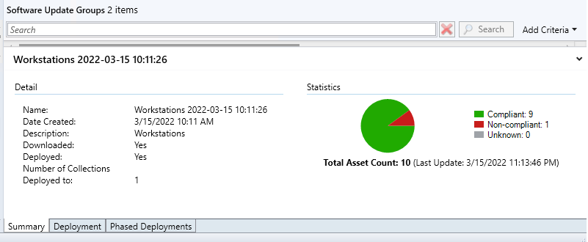
Console’s Software Update Group Summary Graph

Slide 23
Console’s Software Update Group Summary Graph
Select
vALI.Title as 'title',
(vUCS.NumNotApplicable + vUCS.NumPresent
+ vUCS.NumInstalled) as 'Compliant',
(vUCS.NumMissing + vUCS.NumFailed) as 'Non-Complaint',
vUCS.NumUnknown as 'Unknown'
From
dbo.v_AuthListInfo vALI
Left Join dbo.v_Update_ComplianceSummary vUCS
on vALI.CI_ID = vUCS.CI_ID

Slide 24
Top 3 Deployment Views
View Name | Description
v_UpdateDeploymentSummary | Count of devices by Status for each Collection in each Deployment
v_UpdateAssignmentStatus | Compliance, Enforcement, and Evaluation details for each device in each Deployment
v_CIAssignment | Details about deployment
Deployment = Assignment
Pros: Faster than lower-level views, allow for deadline filtering
Cons: May not match their lower-level details
Notes:
v_UpdateDeploymentSummary: Deprecated?
v_UpdateAssignmentStatus : Status for the whole deployment, not just individual updates.
V_CIAssignment: If you want to report on deployment deadline this is the view you need

Slide 25
Update views: DEPLOYMENT STATUS VIEWS
v_UpdateScanStatus
  Information regarding the last software update scan per device.
v_Update_ComplianceStatus
  Compliance and enforcement status per update per device.
  Excludes records where compliance status is unknown or not applicable.
v_UpdateState_Combined
  Compliance for every update per device.
  Updates that are not applicable list their detection states.
  Updates that are required list their enforcement states.
Notes:
v_UpdateState_Combined: This is a weird one to use because the type of data you get back (detection vs enforcement) depends on if the update is defined as required or not.

Slide 26
Update Views: Deployment status views
These three views all contain the state id, state messages, state time, and error codes
v_AssignmentState_Combined
  The single latest state regardless of state type
  One row per device and deployment
v_AssignmentStatePerTopic
  The single latest state for all state types
  Usually three rows: Evaluation Succeeded, Successfully installed updates(s), Compliant
v_UpdateAssignmentStatus
  The single latest state for all types
  One row containing all the data
Notes:
These three views are really just remixing the same data in different ways.

Slide 27
Software Update Deployment Views

Slide 28
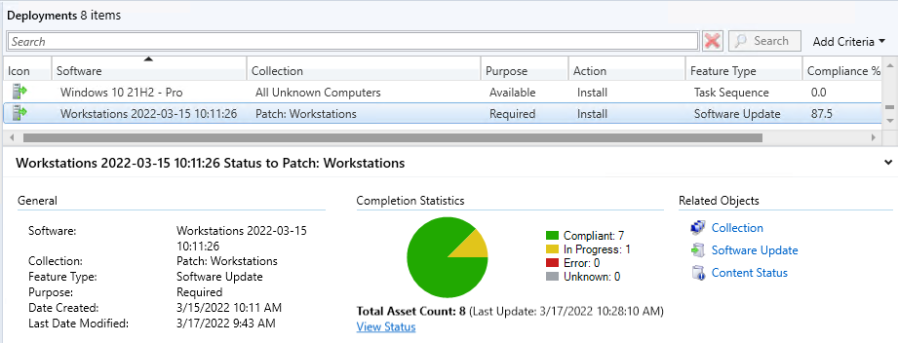
Update Deployment Views: Deployment Summary

Slide 29
Update Deployment Views: Deployment Summary
select vCA.AssignmentName, vCAS.*
from
  (select distinct vCATCI.AssignmentID
  from v_UpdateCIs vUCI
  left join v_CIRelation vCR
  on vUCI.CI_ID = vCR.FromCIID
  left join v_CIAssignmentToCI vCATCI
  on vCR.ToCIID = vCATCI.CI_ID
  where CIType_ID = 9) As SUGAssignments
Left Join v_CIAssignment vCA
on SUGAssignments.AssignmentID = vCA.AssignmentID
Left Join v_CIAssignmentSummary vCAS
on SUGAssignments.AssignmentID = vCAS.AssignmentID

Slide 30
Update Views: Status of Deployments Older than X Days
declare @days integer = 1
Select
vRS.NetBios_Name0,
vCA.AssignmentName,
vUAS.IsCompliant,
vUAS.ComplianceTime,
vCA.EnforcementDeadline,
vSN_Compliance.StateDescription as 'Compliance',
vSN_Enforcement.StateDescription as 'Enforcement',
vUAS.LastEnforcementErrorCode,
vSN_Evaluation.StateDescription as 'Evaluation'
From
dbo.v_UpdateAssignmentStatus vUAS
Left Join v_CIAssignment vCA
on vUAS.AssignmentID = vCA.AssignmentID
Left Join v_R_System vRS
on vUAS.ResourceID = vRS.ResourceID
Left Join v_StateNames vSN_Compliance
on vSN_Compliance.TopicType=300
and vUAS.LastComplianceMessageID = vSN_Compliance.StateID
Left Join v_StateNames vSN_Enforcement
on vSN_Compliance.TopicType=301
and vUAS.LastEnforcementMessageID = vSN_Enforcement.StateID
Left Join v_StateNames vSN_Evaluation
on vSN_Compliance.TopicType=302
and vUAS.LastEvaluationMessageID = vSN_Evaluation.StateID
Where
vCA.EnforcementDeadline < DATEADD(day, (@days * -1), GetDate())
Order by
1

Slide 31
Top 3 Software Update Details Views
v_UpdateInfo | Details about each update and update group
v_AuthListInfo | List of Software Update Groups
v_Update_ComplianceStatus | Status, Enforcement, Error, and Changed info per scanned update per device
v_CICategoryInfo | Update Classification, Product, Company
Pros: Most accurate and flexible results possible
Cons: Do not scale (every update x every device = a lot of rows)
Notes:
v_Update_ComplianceStatus = only includes scanned updates. v_Update_ComplianceStatus add unscanned updates.

Slide 32
Update views
v_EULAContent:
  CONVERT(varchar(max),EULAText)
v_UpdateCIs:
  Update (Type 1) vs Update Bundle (Type 8)
  Use v_UpdateInfo instead
v_UpdateContents: Use to map update data to the content views

Slide 33
UPDATE Views: v_UpdateInfo
Has basic information needed for most update queries
  Title and Description
  Bulletin and Article IDs
  Is Deployed, Expired, Tombstoned
  Max Execution Time
  KB URL
CIType_ID
  8: Software Update
  9: Software Update Group

Slide 34
Update views: v_Authlistinfo
This view lists all of your Software Update Groups (SUGs)
Created By: will equal ‘AutoUpdateRuleEngine’ if created by an ADR.
Description: will equal the name of the ADR if created by an ADR.
Notes:
Use this to run reports on the latest updates you’ve deployed.

Slide 35
Update views: v_UpdateAssignmentStatus
Contains latest Compliance, Enforcement, and Evaluation states, times, and error codes
Interesting Fields:
  IsCompliant: A simple yes, no, or unknown
  LastEnforcementIsRebootSupressed
  Includes the message time as well as the time the status last changed
v_UpdateAssignmentStatus_Live
  A subset of non-live view.
  IsCompliance is null if new compliance data has been received but not summarized.

Slide 36
Software Update Detail Views

Slide 37
Update Views: Getting LATEST SUG For ADR
declare @AdrName varchar(max) = 'ADR 2'
Select
ALI.CI_ID,
ALI.Title
From
dbo.v_AuthListInfo ALI
Where
ALI.Description = @AdrName
AND ALI.CreatedBy='AutoUpdateRuleEngine'
AND ALI.IsLatest=1
Order By
ALI.DateCreated DESC
Notes:
This is the basis for creating reports on the updates you just deployed and allows you to create subscriptions for specific ADRs

Slide 38
Update Status by device including Category
Select
vRS.NetBIOS_Name0 as 'DevicedName',
vSN_Status.StateDescription,
vCCI.CategoryInstanceName as 'UpdateClassification',
vUI.Title,
vUI.Description,
vUI.InfoURL,
vUI.IsSuperseded,
vUI.ArticleID,
vUI.BulletinID,
vUI.MaxExecutionTime,
vUCS.LastStatusChangeTime,
vUCS.LastErrorCode
From
dbo.v_Update_ComplianceStatus vUCS
Left Join dbo.v_UpdateInfo vUI
on vUCS.CI_ID = vUI.CI_ID
Left Join dbo.v_R_System vRS
on vUCS.ResourceID = vRS.ResourceID
Left Join dbo.v_StateNames vSN_Status
on vSN_Status.TopicType = 500
and vSN_Status.StateID = vUCS.Status
Left Join v_CICategoryInfo vCCI
on vCCI.CategoryTypeName='UpdateClassification'
and vUCS.CI_ID = vCCI.CI_ID
Where
vUI.CIType_ID = 8 -- Only select individual software updates
Notes:
If you want to look at update status and filter on UpdateClassification

Slide 39
Top 5 Important SCCM views!
View Name | Description
v_Collection | List of Collection Names
v_FullCollectionMembership | List of who or which device is within each collection!
v_CombinedDeviceResources | Combine view with many useful details such as Endpoint details; Scan dates; Online status; Etc!
v_R_System_Valid | List of devices (computers) discovered by SCCM which have the SCCM client installed
v_GS_SYSTEM_CONSOLE_USAGE_MAXGROUP | Who is the Top Console User!

Slide 40
v_Collection and v_FullCollectionMembership
Declare @CollName varchar(max) = 'All Systems'
Select
FCM.ResourceID
From
dbo.v_Collection Coll
join dbo.v_FullCollectionMembership FCM
on Coll.CollectionID = FCM.CollectionID and Coll.Name = @CollName
Notes:
You are going to want to filter by collection. This is how you filter by collection.

Slide 41
v_R_System_Valid and v_gs_system_console_useage_Maxgroup
Select
R.ResourceID,
R.Netbios_Name0,
R.Active0,
R.AD_Site_Name0,
isnull(SCUM.TopConsoleUser0, isnull(R.User_Domain0 +'\'
+R.User_Name0,'n/a')) as 'Console ID'
from
dbo.v_r_system R
left outer join dbo.v_GS_SYSTEM_CONSOLE_USAGE_MAXGROUP SCUM
on R.ResourceID = SCUM.ResourceID
Notes:
Want to know who owns the device?

Slide 42
v_CombinedDeviceResources
Select
CDR.MachineID,
CDR.CNIsOnline,
CDR.LastStatusMessage,
CDR.LastHardwareScan
from
dbo.v_CombinedDeviceResources CDR
Notes:
Want to filter on active machines?

Slide 43
v_CombinedDeviceResources
Declare @Coll as varchar(250) = 'All Systems'
Select
CDR.MachineID as 'ResourceID',
CDR.CNIsOnline,
CDR.LastStatusMessage,
CDR.LastHardwareScan,
R.Netbios_Name0,
R.Active0,
R.AD_Site_Name0,
isnull(SCUM.TopConsoleUser0, isnull(R.User_Domain0 +'\'+R.User_Name0,'n/a')) as 'Console ID'
from
dbo.v_Collection Coll
join dbo.v_FullCollectionMembership FCM
on Coll.CollectionID = FCM.CollectionID and Coll.Name = @Coll
join dbo.v_CombinedDeviceResources CDR on FCM.ResourceId = CDR.MachineID
join dbo.v_r_system R on FCM.ResourceId = R.ResourceID
left outer join dbo.v_GS_SYSTEM_CONSOLE_USAGE_MAXGROUP SCUM on R.ResourceID = SCUM.ResourceID

Slide 44
Make it not suck
Writing a query is easy. Running it is hard.

Slide 45
Views: Not all views are supported
Garth’s Blog: What Are the Supported SQL Server Views to Use with SCCM Reporting?
Unsupported views are subject to schema changes at any time
Supported views have the smsschm_users security rights
Modifying the permissions is not supported

Slide 46
How to write efficient (Fast) queries
Compare your query to the RBA version?
  Blog: RBA and Non-RBA Queries: When is Slower Actually Faster?
Select only the fields you need
Use indexed fields
Learn to read execution plans
  SQLShack: SQL Server query execution plans – Understanding and reading the plans
Microsoft SQL Server Profiler

Slide 47
How to make sure your queries don’t lie
Test your Queries against the built-in reports
  Compliance 5 - Specific computer
Spot check actual devices
Monitor client health
Resend status messages
  Sherry Kissenger: ConfigMgr RefreshServerComplianceState as a Configuration Item
Notes:
Spot check: compliant and non-compliant
Client Health:

Slide 48
Software Update Dashboard
Get it at DamGoodAdmin.com

Slide 49
Dashboard

Slide 50
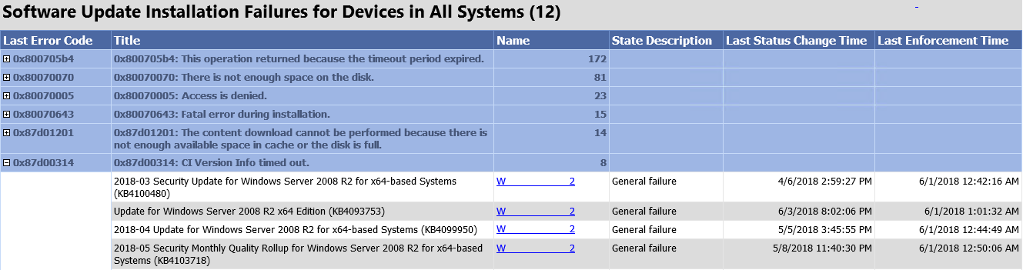
Installation Failures

Slide 51
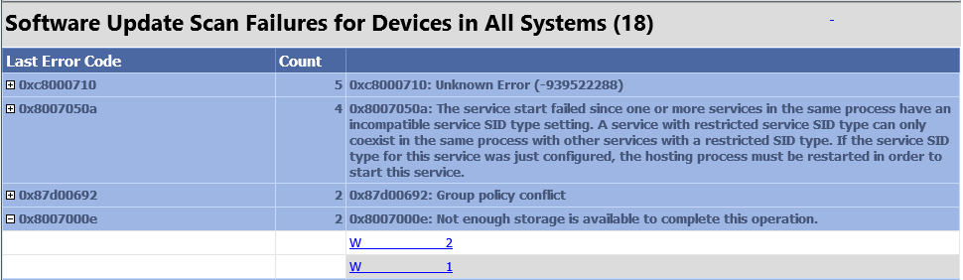
Scan Failures

Slide 52
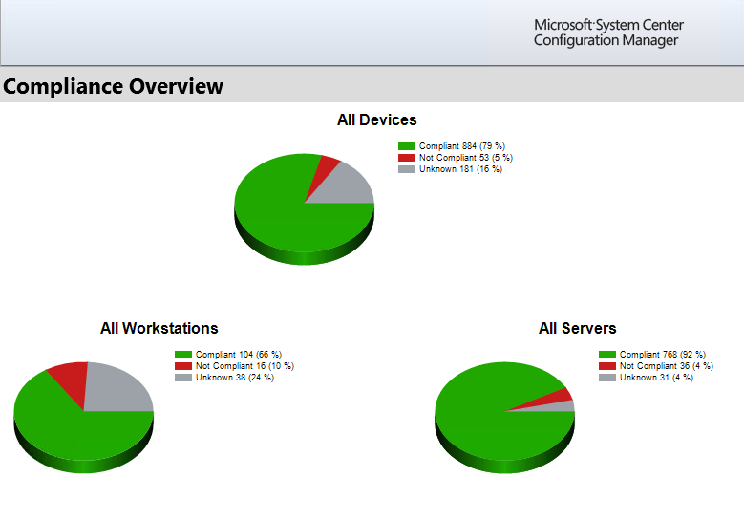
Compliance OVerview

Slide 53
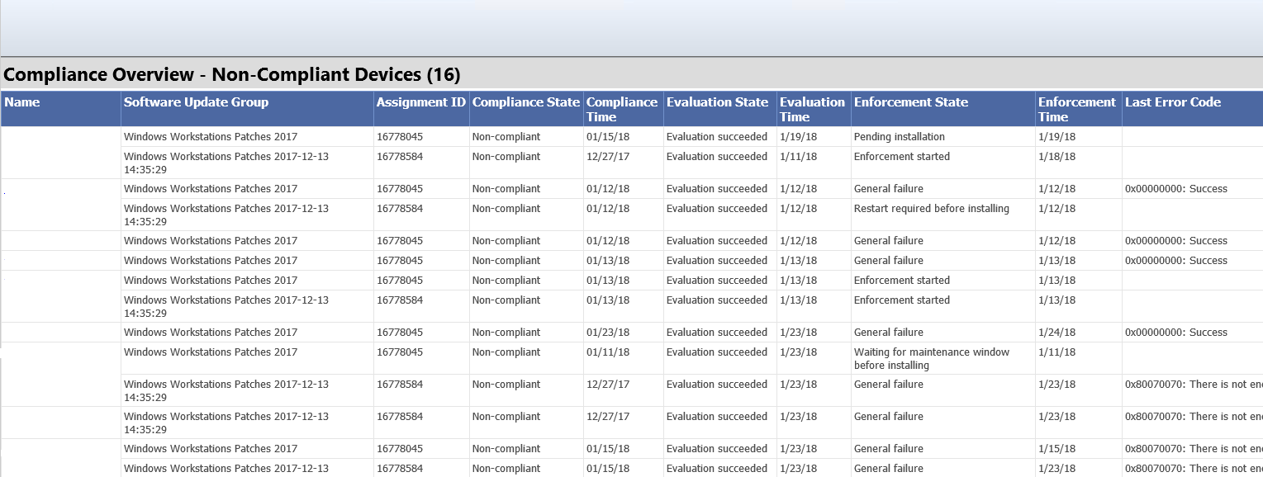
Compliance Device OVerview

Slide 54
Compliance Device OVerview

