Slide 1



Why Endpoint Security begin with
Asset Health
Kent Agerlund, Principal Consultant & founder @ CTGlobal
Anders Roedland, Managing Consultant @ CTGlobal US

Slide 2
Introduction to Asset Health
The Holistic Approach
ConfigMgr Client Health
ConfigMgr Component Health
Consequences of Poor Asset Health
Securing Endpoints

Slide 3

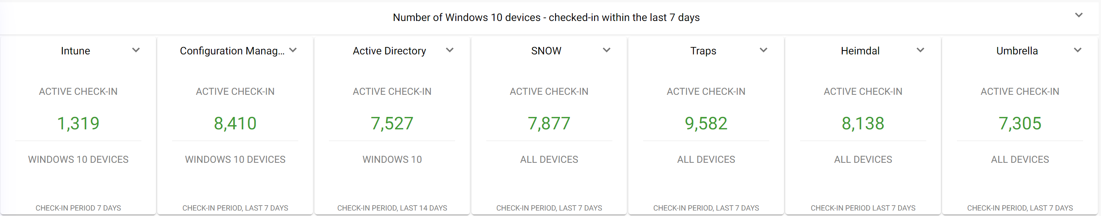
The Holistic Approach
Notes:
AD - example
var directoryEntry = new DirectoryEntry("LDAP://contoso.com");
var timestampLast14Days = DateTime.UtcNow.AddDays(-14).ToFileTimeUtc(); // will produce a value like 125899488000000000
var queryString = $"(&(objectClass=computer)(lastLogonTimestamp>={timestampLast14Days}))";
var propertiesToLoad = new string[] { "cn", "canonicalName", "operatingSystem", "operatingSystemVersion",
"lastLogonTimestamp", "whenCreated", "whenChanged", "distinguishedName"};
DirectorySearcher search = new DirectorySearcher(directoryEntry, queryString, propertiesToLoad, SearchScope.Subtree);
search.PageSize = 1000;
using (SearchResultCollection src = search.FindAll())
{
foreach (SearchResult result in src)
{
DirectoryEntry computer = result.GetDirectoryEntry();
.....
}
}

Slide 4
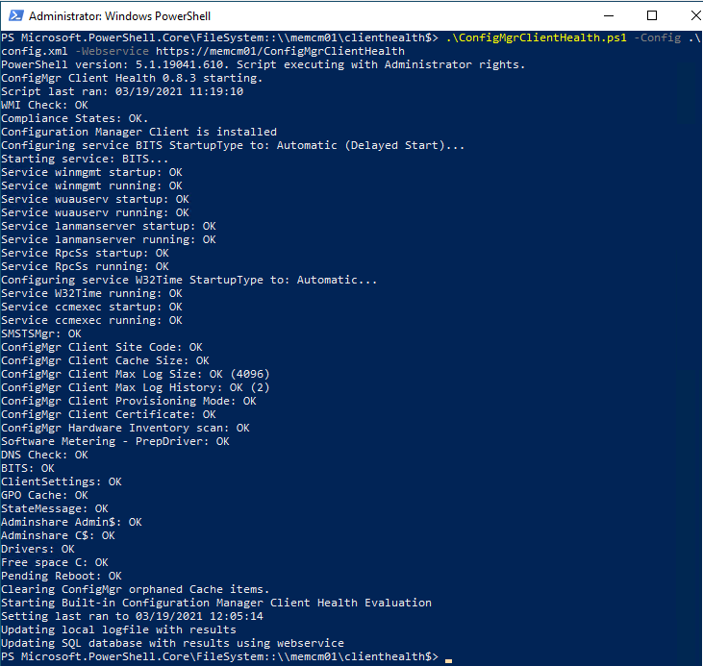
ConfigMgr Client Health
The client CAN break!
PowerShell based solution to fix broken clients
Automate the fix at large
Webservice changed to .NET Framework 4.8
SOON: A new console extension
Notes:
Anders will share how Client Health works and also give demo
The client can break. Don’t loose management of your endpoints.
It’s powershell based script, approximately 3500 lines of code. Tests specific components to verify if it is working or broken, and implement the respective fix. In some cases will reinstall the client.
Its initiated by the client itself, does not depend upon ConfigMgr to deploy it. ConfigMgr may not be capable of deploying the fix if the client itself is broken and ConfigMgr no longer have working management of it.
Deploy it at large using Group Policy. Scheduled tasks will start the script as system.

Slide 5
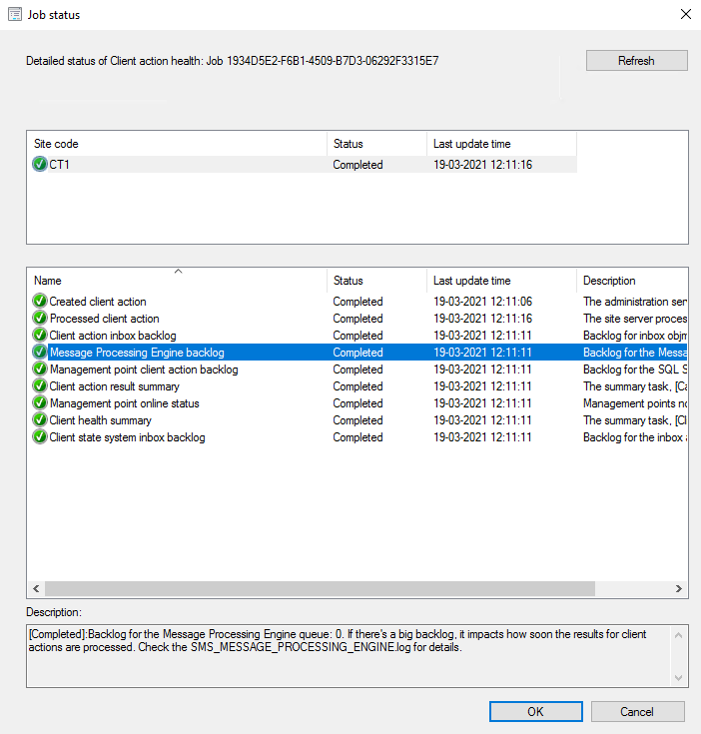
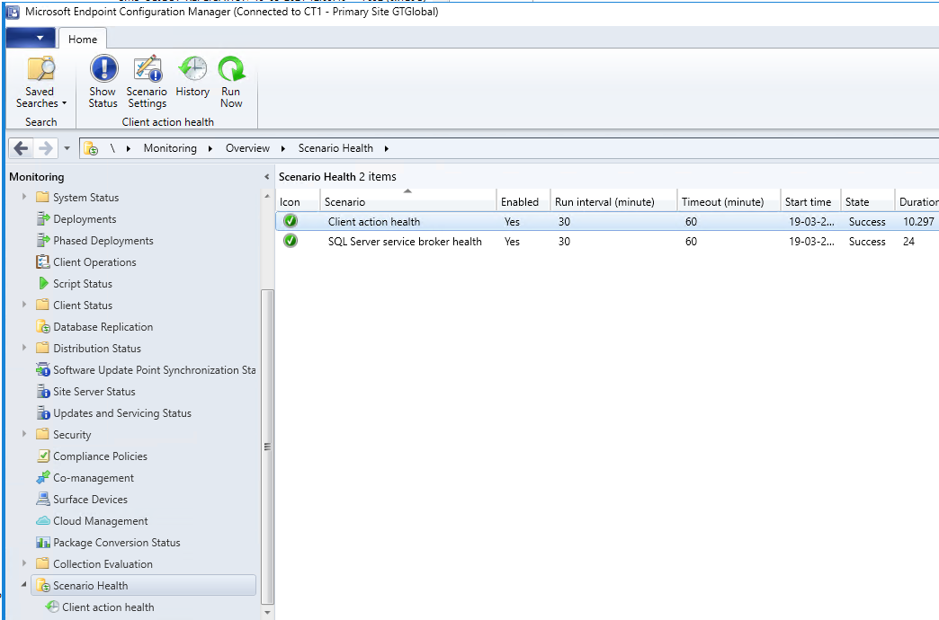
Health monitoring feature in CM2010
Monitor the health of end-to-end scenarios.
  Simulates activities to expose performance metrics and failure points.
  These synthetic activities are similar to methods that Microsoft uses to monitor some components in its cloud services.
SQL Broker
Client health
Created client action: Tests that the site can create a client action using the administration service.
CMPivot configuration: Makes sure that CMPivot is correctly configured see rcmctrl.log.
Client action result: Tests that the CAS receives client action results from primary sites. This test can fail if the SQL Server Service Broker is unhealthy, or the site is in maintenance mode.
Processed client action: For more detail, see objreplmgr.log.
Client action inbox backlog: Checks the backlog for the objmgr.box inbox. For more detail, see objreplmgr.log.
Message Processing Engine backlog: Checks the backlog for the message processing engine. For more detail, see SMS_MESSAGE_PROCESSING_ENGINE.log.
Management point client action backlog: Checks the backlog for the SQL Server service broker queue ConfigMgrBGBQueue. Check the scenario health for the SQL Server service broker. For more detail, see the management point's bgbserver.log.
Client action result summary: Checks the task to calculate client operation summary. For more detail, see statesys.log.
Management point online status: Checks that management points are online and able to send actions to clients. For details, ccmexec.log, bgbsetup.log, and bgbserver.log.
Client health summary: Checks the client health scheduled task. For more detail, see statesys.log.
Client state system inbox backlog: Checks the backlog for the inbox auth\statesys.box\incoming. For more detail, see statesys.log.

Slide 6
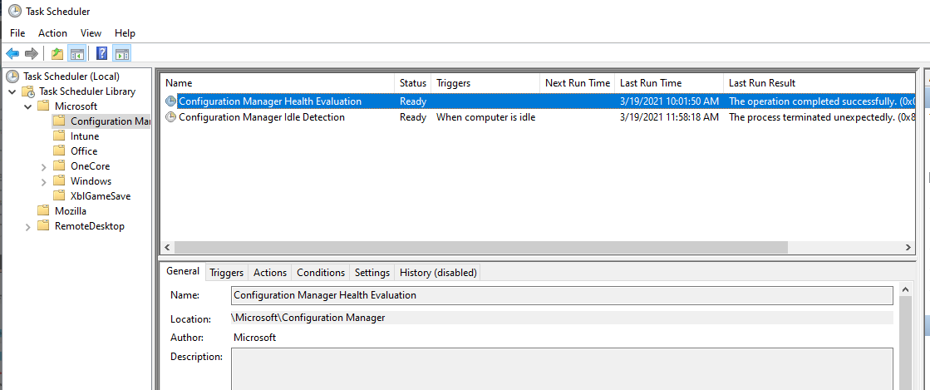
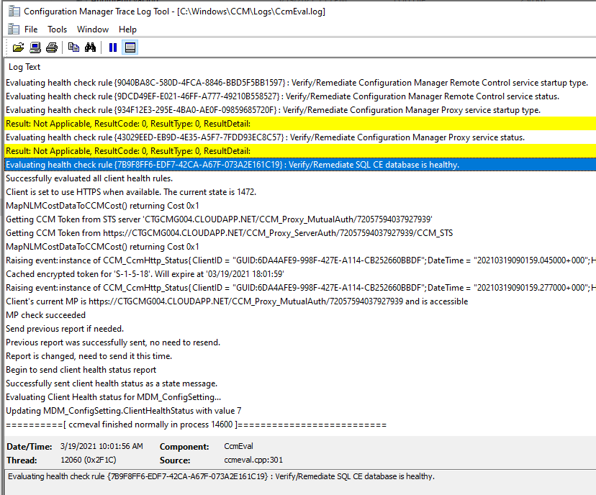
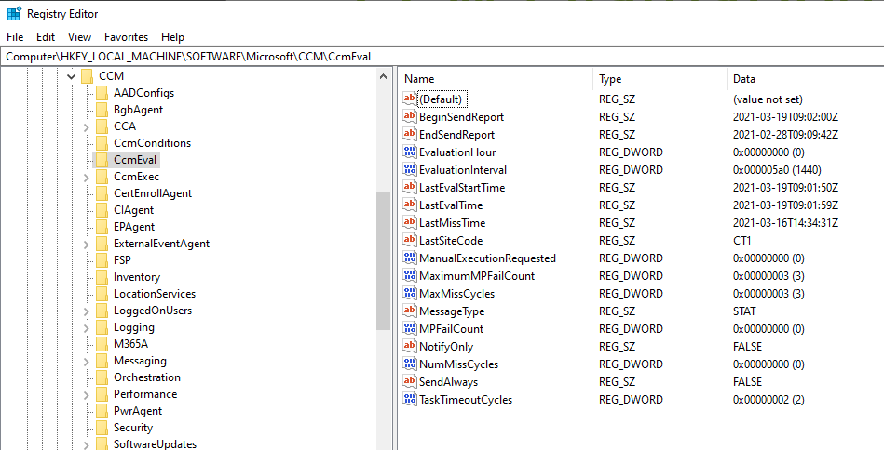
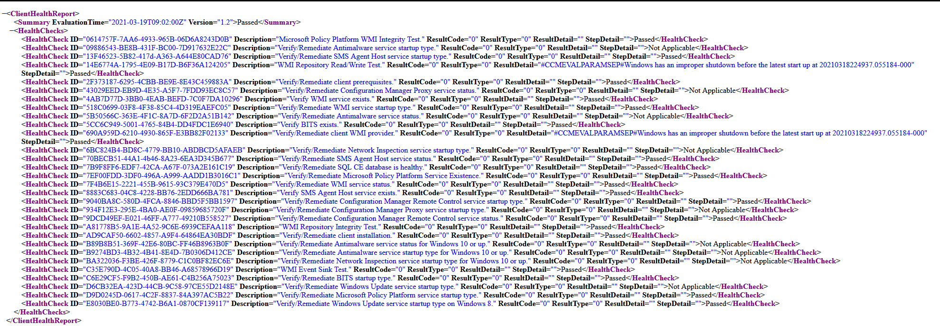
CCM Evaluation

Slide 7

ConfigMgr component Health
root\ccm\softwareupdates\updatesstore ccm_updatestatus
Healthy
HW Inv
Update Scan
Heartbeat
SW Inv
Boundary group
Update install
ROOT\ccm\InvAgt InventoryActionStatus
root\ccm\LocationServices BoundaryGroupCache
Win32_QuickFixEngineering

Slide 8
Securing Endpoints
Defender for Endpoint
Install updates (Windows and applications)
Make sure ConfigMgr client is healthy
Notes:
Consolidating consequence of poor asset health with this one
High level demo of Defender for Endpoint in highly compromised demo environment.
Overview of security recommendations, showing how vulnerable you are when not installing updates
With advanced threat hunting, look at compromised domain controller that gets RDP logins from all over the world

