Slide 1
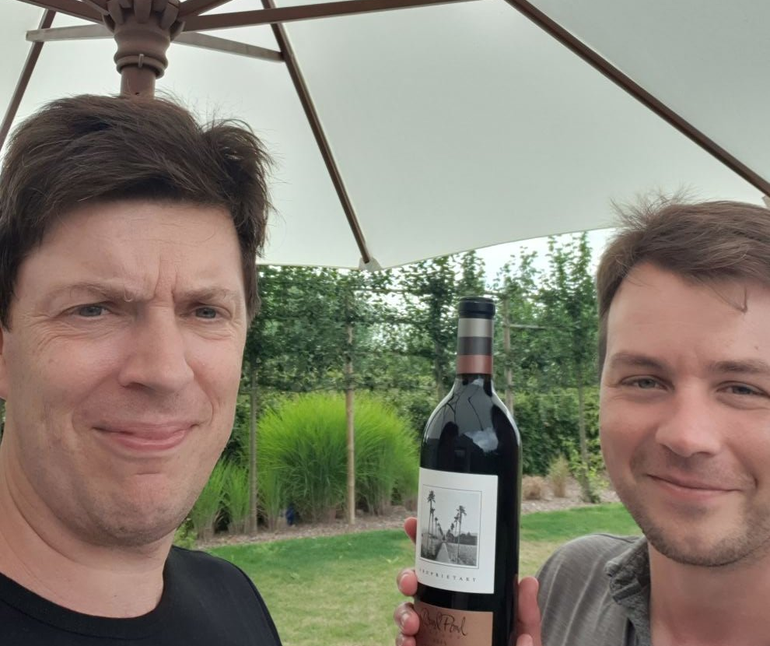


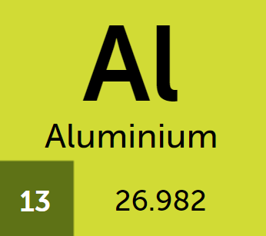


Real World Use of Windows Defender Application Control
Kim Oppalfens - https://twitter.com/TheWMIGuy
Kim.Oppalfens@oscc.be
https://www.oscc.be/

Slide 2
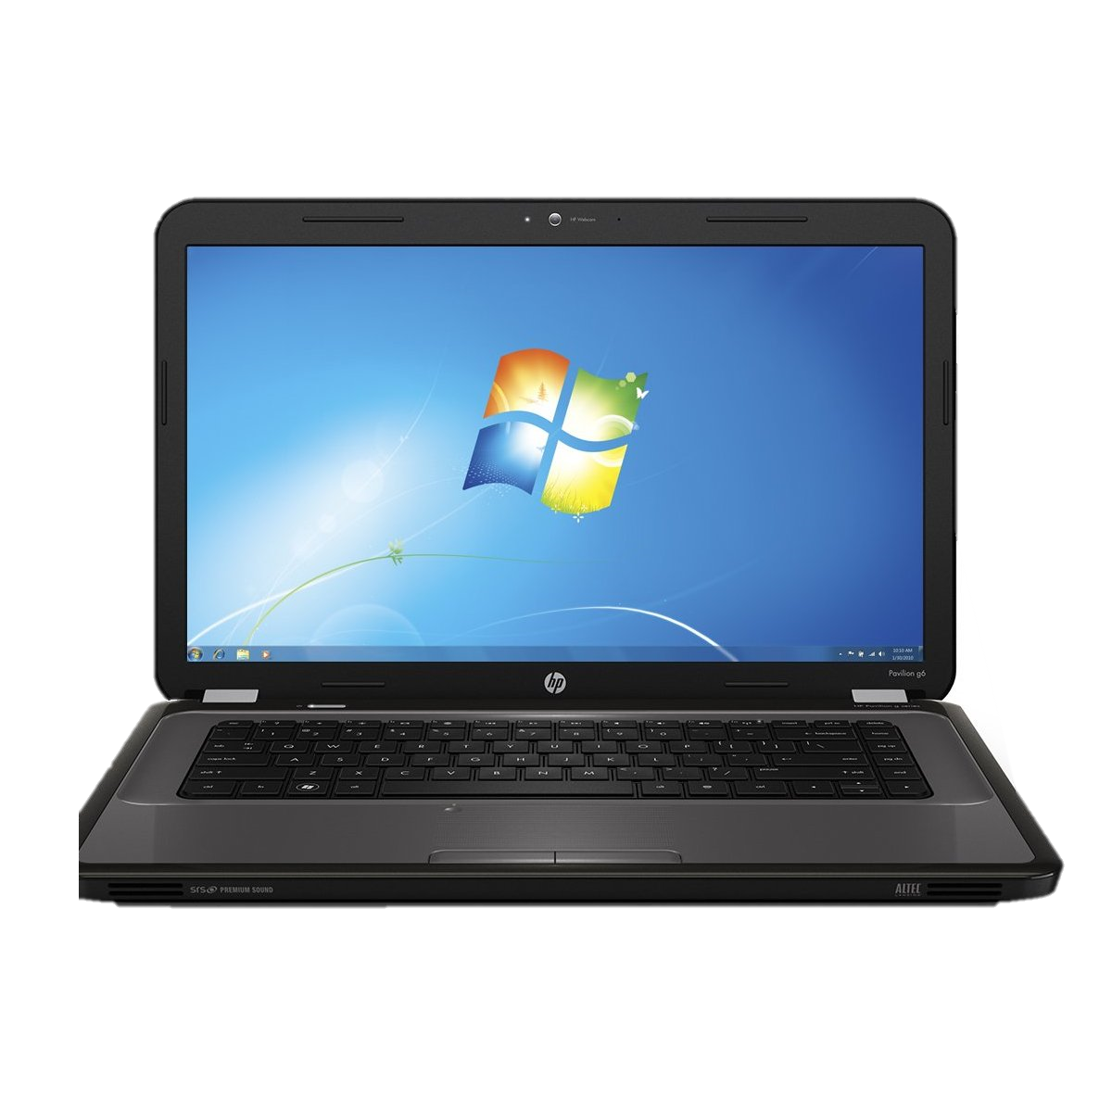

Why WDAC
Open vs closed devices
K

Slide 3


Application approval list benefits
Protects against 99% of automated malware & ransomware attacks
Enforces solid processes and security practices
10
T

Slide 4

Application Control
Paradigm shift
Code integrity aka
  Non-jailbroken Windows
  Windows-S
  Implement chain of trust

Slide 5
Major WDAC Challenges
Ruleset mainly build in PowerShell
Ultra basic MEMCM implementation
Unfortunate Intune implementation*

Slide 6
Tips to move to enforcement as swiftly as possible
1 “Policy” for the entire company
  If you consider software trustworthy to run on Device A, what motivation do you have not to trust it on Device B?
Abstract approval away from your XML/Binary policy

Slide 7
WDAC in a managed environment (MEMCM Reverse Engineered)
DeviceGuardHandler.log in debug mode
$commandbytes = [System.Convert]::FromBase64String($EncodedCommand1)
$decodedCommand = [System.Text.Encoding]::Unicode.GetString($commandBytes)
Enable PowerShell Transcript logging
    Administrative Templates\Windows Components\Windows Powershell\Turn on PowerShell Transcription
Notes:
Dev Machine \ C:\Windows\Logs\PSLogging\12032021\PowerShell_transcript.BE-HER1-PC1975.yK80YtFe.20210312065333.txt

Slide 8
Windows Defender Application Control in a managed environment (MEMCM) -Results
4 Scripts
  Configure Applocker & Managed installer rules for CCMExec & CCMSetup
  Create Hash rules for MEMCM Client & Dependencies & Output to CCMFiles.XML
  Convert CCMFiles.XML to WDAC Policy XML name SCCMPolicy.xml
  Merge different WDAC Policy XML’s
    DefaultWindows Policy (C:\Windows\Schemas\codeintegrity\ExamplePolicies\DefaultWindows*
    SCCMPolicy.XML
    Codeintegrity_*.xml C:\Windows\CCM\DeviceGuard
  Convert policy to binary and apply
Notes:
Dev Machine \ C:\Windows\Logs\PSLogging\
Dependencies: VCRedist, Managed defender, Firewall Configuration Provider, Microsoft Policy Platform

Slide 9
WDAC Managed installers
Fun with flags Extended Attributes
Managed Installers explained

Slide 10
WDAC Managed installers
Nitty gritty details
NTFS Extended attributes
EAQuery by Joakim Schicht from Norway
$Kernel.Smartlocker.Originclaim
Notes:
.\EaQuery.exe /target:"C:\Program Files (x86)\tools\wdactools\eatools" /mode:0 /verbose:2 /recurse:1 /identifier:$kernel.smartlocker

Slide 11
WDAC Managed installers
Gotcha’s
Only works for applications installed after a client received a WDAC MI policy
Can’t be used for executables a user can use to write files to disk
Only works for Installers that don’t break the process tree
  This eliminates the Install Package & Install Application options in a TS

Slide 12
Security Catalogs
PackageInspector
Catroot
Well-Known driver mechanism
MSIX

Slide 13

Windows Defender Application Control in a managed environment (Intune)
Current UI Reboots devices (Both Device Configuration Profiles & EP Node)
  https://microsoftintune.uservoice.com/forums/291681-ideas/suggestions/38387167-applying-wdac-windows-defender-application-contro
Use OMA Uri
  ./Vendor/MSFT/ApplicationControl/Policies/MYPolicyID/Policy.
Use script to Define Applocker MI Policy
  The Applocker CSP doesn’t support Managed Installer rules
Use Script to deploy Catalog files

Slide 14
Application Control - Getting started
Audit first / Audit now
Good initial candidates
  Servers: Active Directory, PKI, MEMCM
    Excessive / Confusing Applocker logs
  Workstations
    Find department/group of devices with Well-Known, Well-Understood workloads

Slide 15
Key Takeaways
Start today*
  It’ll give you a bunch of info
  It’ll create a number of Extended Attributes you benefit from down the line
  *If you use SEP, run some tests first
    The Applocker Filter Driver and SEP can conflict making devices ultra-slow

Slide 16
Training Offer
8 * 2 hour sessions covering WDAC in a managed environment
  Build a WDAC policy you can enforce for Information workers
  Build a WDAC policy you can enforce on Domain Controller & SCCM Servers
To be held in 4 consecutive weeks starting early November
Time Zone slot that allows across the world participation (Evening in Belgium)
  Probably 10Am-12Am Seattle time* (*assuming my TimeZone + DST math works out)
Remember code NWScug1903
Express an interest by mailing kim.oppalfens@oscc.be

