Slide 1



Deploying
Office 365 ProPlus Like a Pro
Deploying
Office 365 ProPlus Like a Pro
Friday, May 15th,2020
Gary Blok (@gwblok)
Mike Terrill (@miketerrill)
Arizona Systems Management User Group
Notes:
Gary starts off presenting

Slide 2
Agenda
Goals
Install Script
Applications
Deployments
Toast Notifications
Notes:
MIKE

Slide 3
Goals
Provide consistent, reusable installation method that can be used to upgrade from Office 2016 or perform a fresh installation of Microsoft 365 Office on the corpnet and VPN (i.e. no CDN or CMG)
  Remove items not covered by the O365 ODT
  Upgrade needs to replace like for like (i.e. Access, Project, Visio)
  Avoiding the XML H3LL
Provide a pleasant user experience
  Customs notifications
  Installation available when notified (i.e. not waiting for download)
  Ability to select Project or Visio after install (and not wait for another 2.5 GB download)
Installs need to be current (source content needs to be kept fresh)
Support for Self-Service as well as Required Deployments
Use native solutions where possible (no PADT)
Support for different languages
Notes:
MIKE – Bullet 1
GARY – Bullet 2
MIKE – Bullet 3
GARY – Bullet 4
MIKE – Bullet 5
GARY – Bullet 6

Slide 4
Lessons learned along the way..
Packages
  Pros:
    Single Content, several programs
    Um..... yeah, that was it
  Cons:
    No Icon in Software Center
    No "link" in Software Center (Unable to provide direct link to App to leverage in email or toast)
    No detection method
Task Sequence
  Pro
    Task Sequences are the coolest
  Cons
    No Icon in Software Center
    Using a TS in an application to install a package... it's a joke
Notes:
Packages – Mike
Task Sequence - Gary

Slide 5
Application Model
Cons
  Each App and App DT has its own Content
    That's a lot of content when you have to support several different flavors of Office / Addons
    No reuse of already cached content for CM Peer Cache or legacy 3rd party P2P solutions (BranchCache doesn’t have these issues)
Pros
  ICONS, ICONS, ICONS! Let's face it, if it doesn't look pretty, people instantly assume the experience is going to stink (would you really install something from the AppStore on your phone if it didn’t have an icon?)
  Direct Link in Software Center
    softwarecenter:SoftwareID=ScopeId_7520050B-F9BC-452E-AD92-210A44FC8FDE/Application_dafe0527-e422-443a-ac93-97bdf20cdb22
    Leverage Toast Notifications
    Leverage Email Link for Communications
  Detection Method
    Provides the ability to Change Channel and Confirm Content
  Requirements (To run different App DTs)
    Allows the flexibility to accommodate different languages in the same Application Deployment
Notes:
Cons – Mike
Pros - Gary

Slide 6
Winner:
Task Sequences!!!
Notes:
MIKE

Slide 7
Winner:
Application Model
Notes:
GARY

Slide 8

Basics of the Apps:
365 Content App
Additional Language Scenario
365 Content App
365 Content App DT
365 Content App DT
365 Lang Content App
365 Install
365 Install w/ Additional Lang Support
365 AppDT
Language Content App DT
365 non-en-US AppDT
Microsoft 365 Semi-Annual Enterprise Channel Application
Notes:
GARY

Slide 9
Break

Slide 10
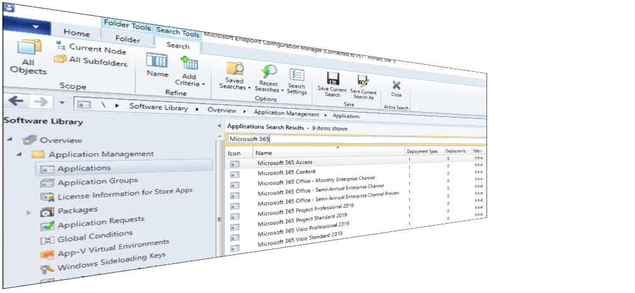
Applications
Notes:
Switch Screen to MIKE
DEMO Time (Server side apps and DTs)

Slide 11
Language App DTs
Notes:
Switch Screen to Gary
DEMO Time (Server side apps and DTs)

Slide 12
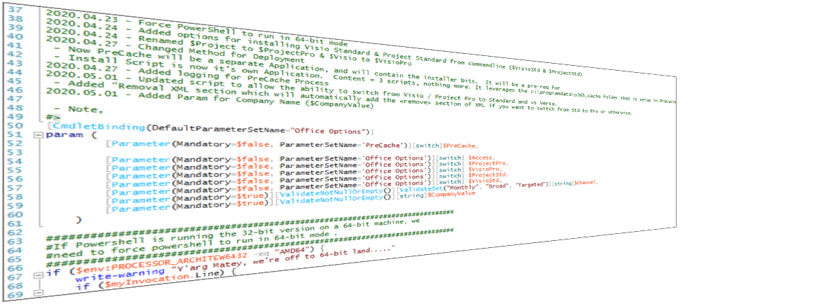
Install Script
Notes:
Still GARY
Demo Time – Install Script
Like for like on upgrade

Slide 13
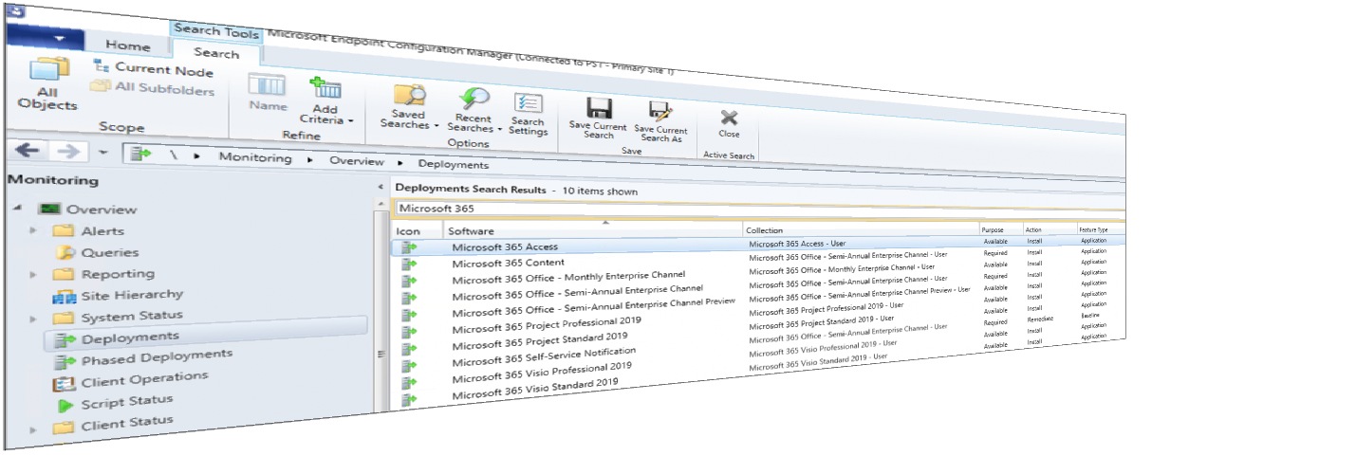
Deployments
Notes:
Switch Screen to MIKE
Show how the deployments for the Content App and M365 Office Deployment

Slide 14
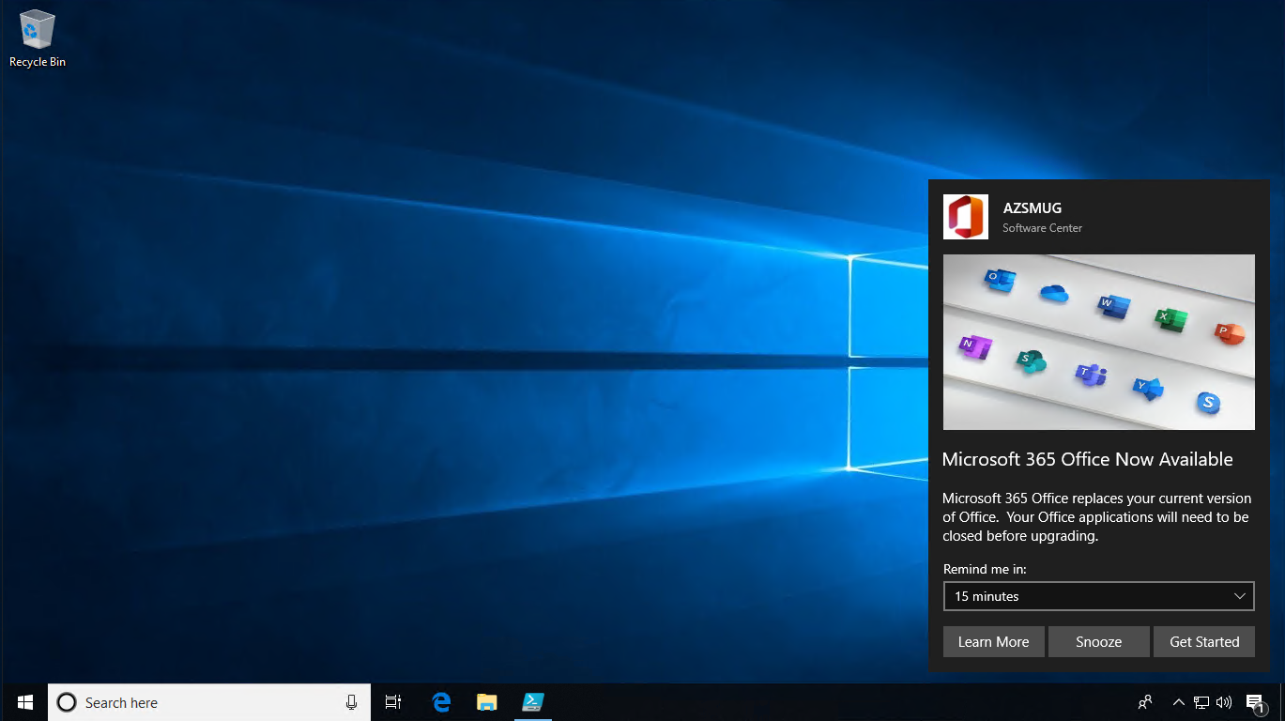
Toast Notification
Notes:
Still Mike – Demo after this slide

Slide 15
UserVoice Items
Option to use SYSTEM context for detection method for a user-based application deployment
Have the ability to pre-deploy an available application on a user’s primary device
Application Detection - Add Return Code Option - Clear Install History
Ability to trigger reboots through the client WMI SDK
Allow immediate restart after user-initiated installation in Software Center
Default expansion of 'More information' section in 'Required software changes…' dialog
Allow custom icons in software center for Task Sequences
Allow customer icons in software center for Package/Programs

Slide 16
Reference Links
Changes to update channels for Microsoft 365 Apps
Overview of update channels for Microsoft 365 Apps
Update history for Microsoft 365 Apps (listed by date)
Office Deployment Tool Download
A new wave of innovation to help IT modernize servicing of Microsoft 365 Apps for enterprise

Slide 17
Scripts
https://github.com/gwblok/garytown/tree/master/Office365

Slide 18
Questions?

Slide 19
Thank You!

