Slide 1
Troubleshooting Autopilot
Spencer Shumway
Windows Autopilot PM

Slide 2
Windows enrollment cases vs all others
Months | Enrollment\Autopilot | % total | Enrollment\Windows | % total | Monthly Total | Combined % total
July | 126 | 22% | 159 | 27% | 579 | 49%
August | 145 | 24% | 185 | 30% | 609 | 54%
September | 139 | 24% | 172 | 30% | 573 | 54%
October | 183 | 21% | 306 | 35% | 868 | 56%
November | 209 | 26% | 234 | 29% | 816 | 54%
December | 139 | 23% | 169 | 28% | 593 | 52%
Grand Total | 941 | 23% | 1225 | 30% | 4038 | 54%

Slide 4
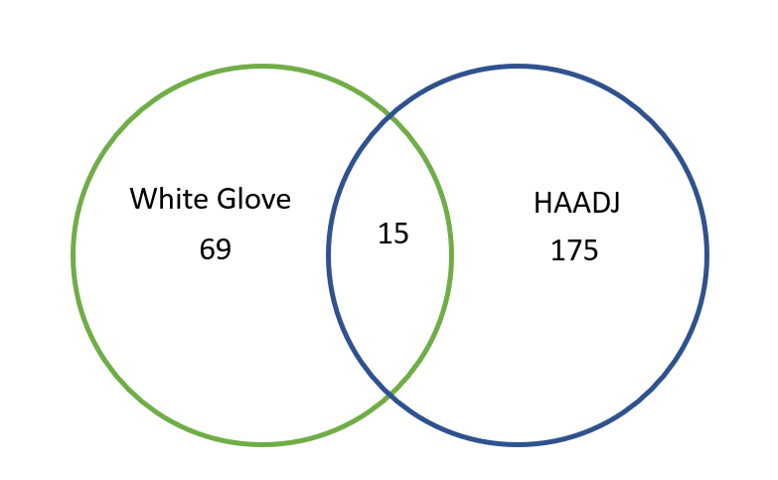

Slide 5
Some common support issues
Orphaned Autopilot devices
Whiteglove + Hybrid issues
(Reg add KLM\SOFTWARE\Microsoft\Provisioning\OMADM\SyncML as solution)
Time sync issue where time zone changes(Backported fix to 3D 1903/1909)
TPM issues(Reset TPM, Update firmware, allow cert acquisition URLs)

Slide 6
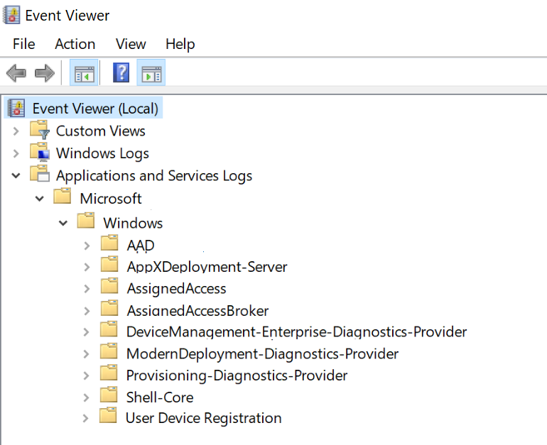
Windows Autopilot // Troubleshooting on Windows 10 1803+
Grab all potentially-interesting information:
  Event logs
  Registry, configuration data
  TPM details (1809+)
  ETL trace files
Windows 10 1803:
    LicensingDiag.exe -cab C:\Autopilot.cab
Windows 10 1809+:
    MDMDiagnosticsTool.exe -area Autopilot;TPM -cab C:\Autopilot.cab
Analyze offline

Slide 7
File name | Usefulness | Comments
AutopilotDDSZTDFile.json | High | This file contains the Autopilot profile settings being used for the device.
CertReq_enrollaik_Output.txt | High | This file only exists when the TPM area is included. It provides a simulation of the TPM attestation process and logs the results, so it’s useful to see why the “real” TPM attestation might be failing.
CertUtil_tpminfo_Output.txt | Medium | This file only exists when the TPM area is included. It provides more details about the TPM chip or firmware used in the device.
DeviceHash_*.csv | High | This contains the serial number and full hardware hash for the device. While that hash might not look useful to you, it tells us a lot about the device, including the version of Windows 10, patches that are installed, TPM firmware version, and a lot more stuff.
IntuneManagementExtension.log | High | This log will capture excruciating detail about the installation of Win32 apps being deployed via Intune. (Use one of the ConfigMgr log viewing tools, e.g. CMTrace.exe, to view this.)
MDMDiagHtmlReport.html | Medium | This is the same report you can get from the Settings app that provides more details on all the MDM policies that have been applied to the device.
MDMDiagReport.xml | Medium | This is a machine-readable XML version of the HTML report above.
MdmDiagReport_RegistryDump.reg | Medium | This dump the contents of a variety of registry keys that are useful to determining the state of the machine, including MDM enrollment details, Autopilot details, and related info. Support technicians may use this to find related information in Intune.
microsoft-windows-aad-operational.evtx | High | This event log shows Azure AD join and Hybrid Azure AD Join-related info.
microsoft-windows-devicemanagement-enterprise-diagnostics-provider-admin.evtx | High | This event log covers MDM enrollment (including failure reasons) and other pertinent MDM activities.
microsoft-windows-moderndeployment-diagnostics-provider-autopilot.evtx | High | This is the key event log used by Autopilot, and one that you’ll almost always want to look at.
microsoft-windows-shell-core-operational.evtx | Medium | This is the event log that the shell uses for most things, including tracking the OOBE process, registering apps when a user signs in, etc.
microsoft-windows-user device registration-admin.evtx | Medium | This event log shows details around Hello for Business and related configuration details.
setupact.log | Medium | If you are familiar with the logs created by Windows Setup, you’ll recognize this one. This logs all the stuff going on in OOBE, and can be useful for troubleshooting any OOBE weirdness.
TpmHliInfo_Output.txt | High | This log (which is created even when not specifying the TPM area) contains basic details about the TPM in the device: the manufacturer, the firmware level of that TPM, whether it has a required EK cert, etc.
Notes:
https://oofhours.com/2019/10/08/troubleshooting-windows-autopilot-a-reference/

Slide 8
Windows Autopilot // Troubleshooting & Diagnostics Vision
Windows 10
Intune
  Proper errors
  Clear
  Timely
  Central
  Connectivity validation
  Troubleshooting
  Monitoring
  Reporting
  Remote log collection
  Configuration validation
Notes:
4:00

Slide 9
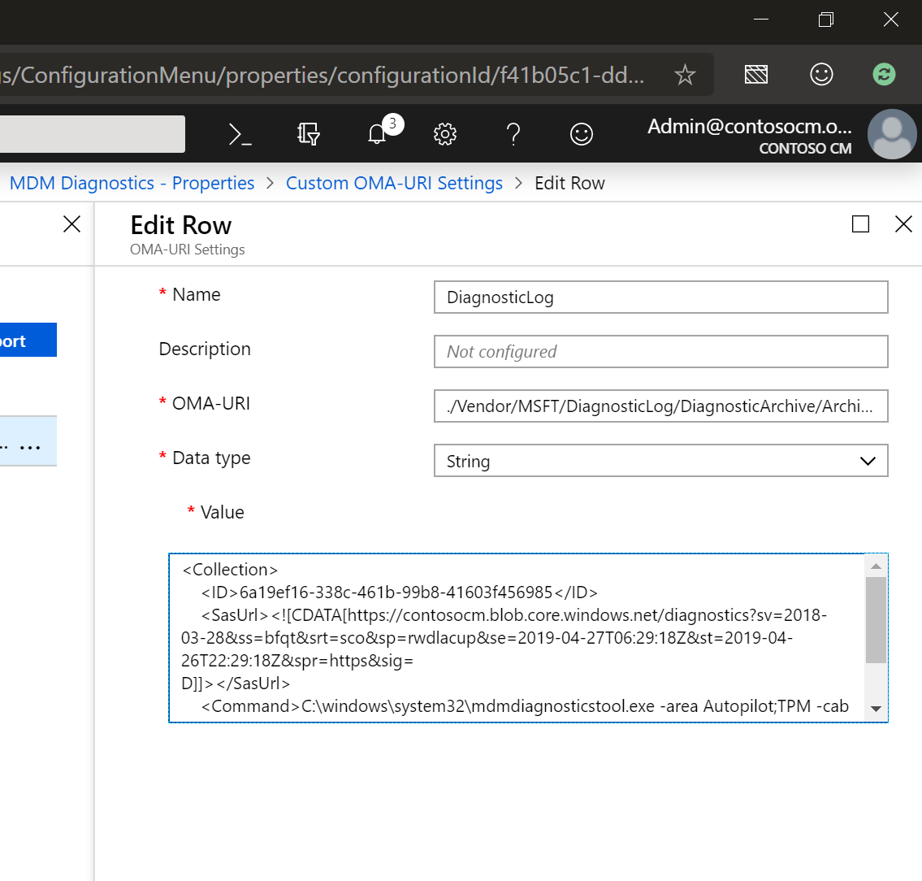
Windows Autopilot // Remote Log Collection via Intune
Requires Windows 10 1903
  Enhancement to DiagnosticLog CSP
  Device must be enrolled (obviously)
On-demand collection
    Run commands
    Collect results, logs, events
    Upload to a specified URL
    Analyze offline
Working to integrate into Intune
For more info on trying this out:
https://oliverkieselbach.com/2019/04/23/on-demand-windows-diagnostic-logs-via-intune/
Notes:
We are looking to add a pre-built list of commands for Autopilot log collection, but that is in the future still

Slide 10
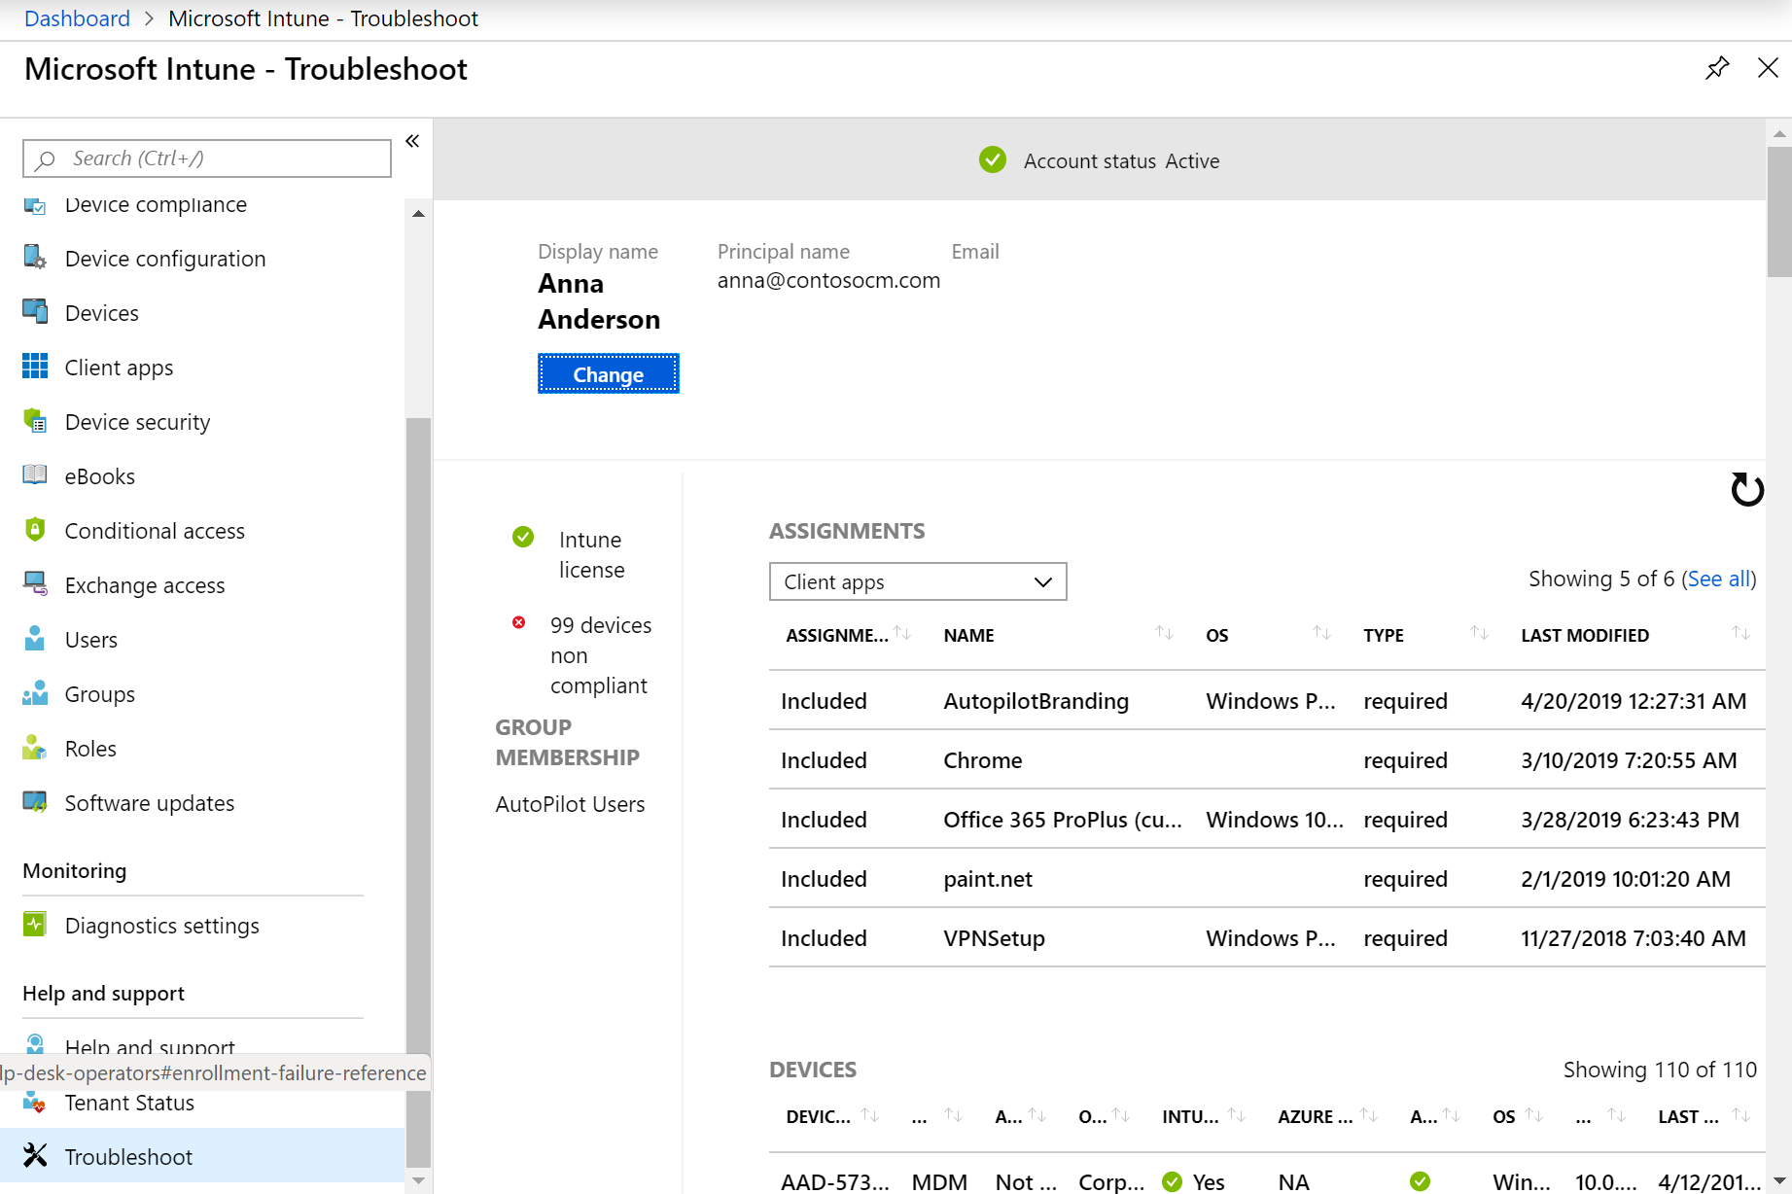
Microsoft Intune // Troubleshooting Pane
Intune portal page
    https://aka.ms/intunetroubleshooting
Displays information focused around a particular user
    See info about assignments, devices, enrollment failures, etc.
For more info:
https://docs.microsoft.com/en-us/intune/help-desk-operators
Notes:
We’d like to add a device view here as well, still pending

Slide 11
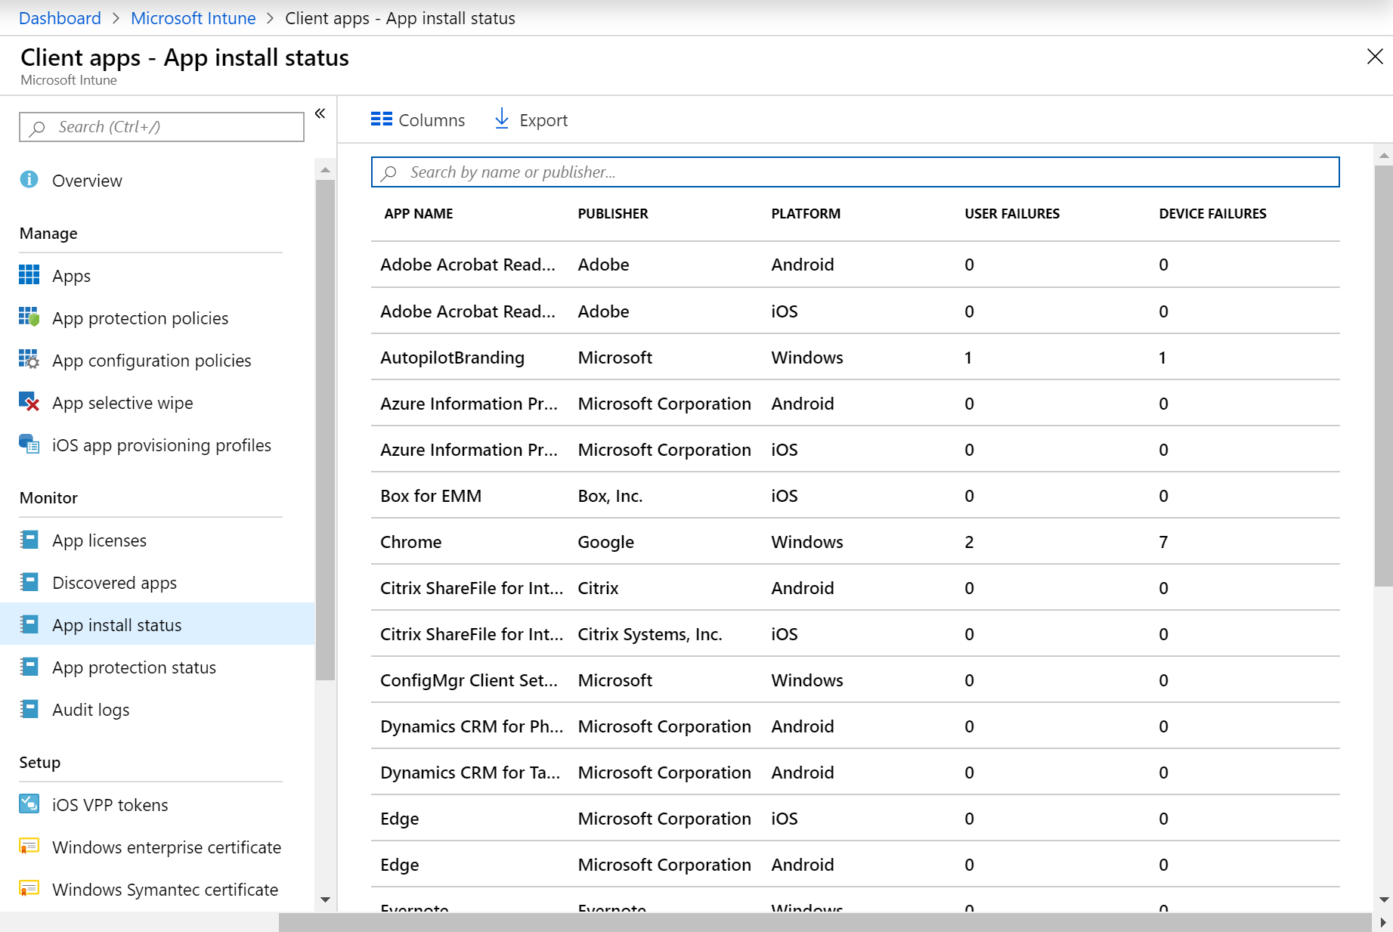
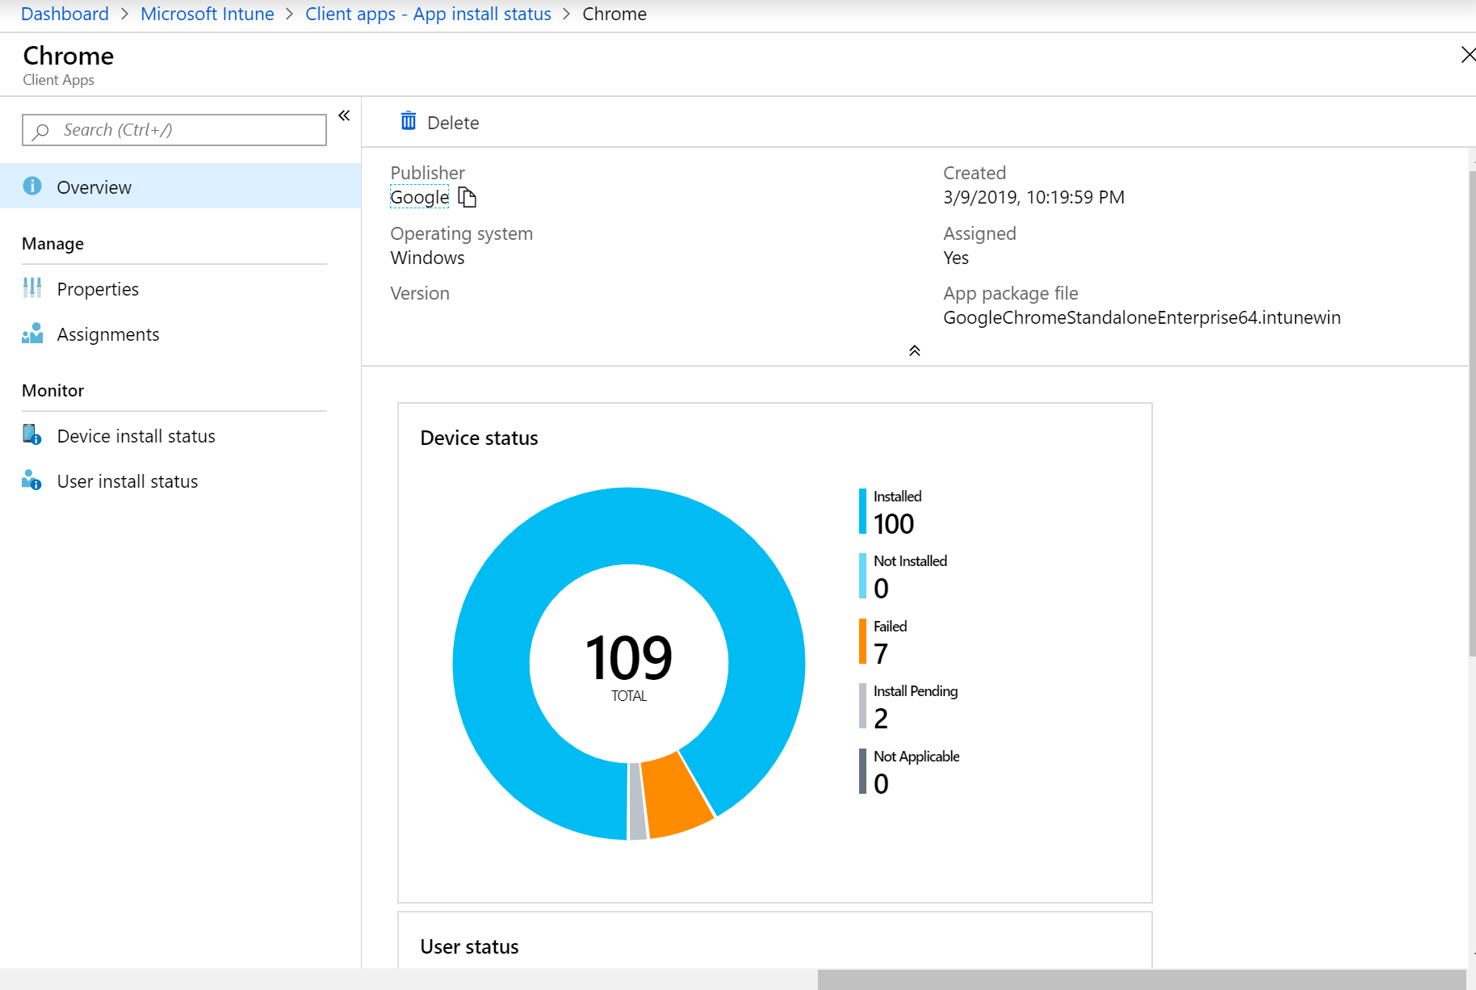
Microsoft Intune // App Install Status Pane
Intune portal page
    Navigate to Intune -> Client apps -> App install status
Displays information about deployed apps
    Drill into app-specific details
For more info:
https://docs.microsoft.com/en-us/intune/apps-monitor#device-and-user-status-graphs

Slide 12
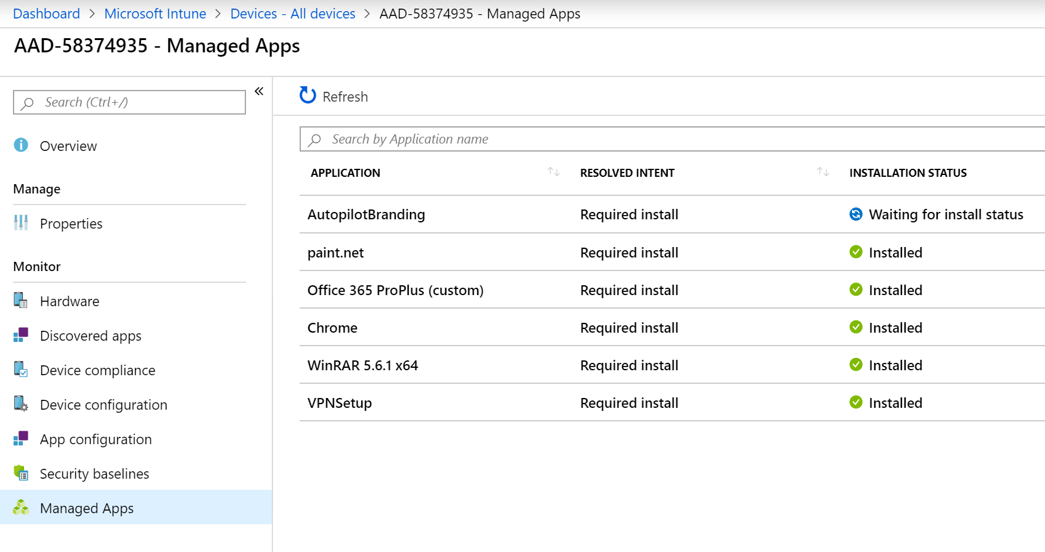
Microsoft Intune // Device Managed Apps Pane
Intune portal page
    Navigate to Intune -> Devices -> All Devices, choose specific device, select Managed Apps
Displays all device-targeted apps
    See status, drill into details
For more info:
https://docs.microsoft.com/en-us/intune/help-desk-operators

Slide 13
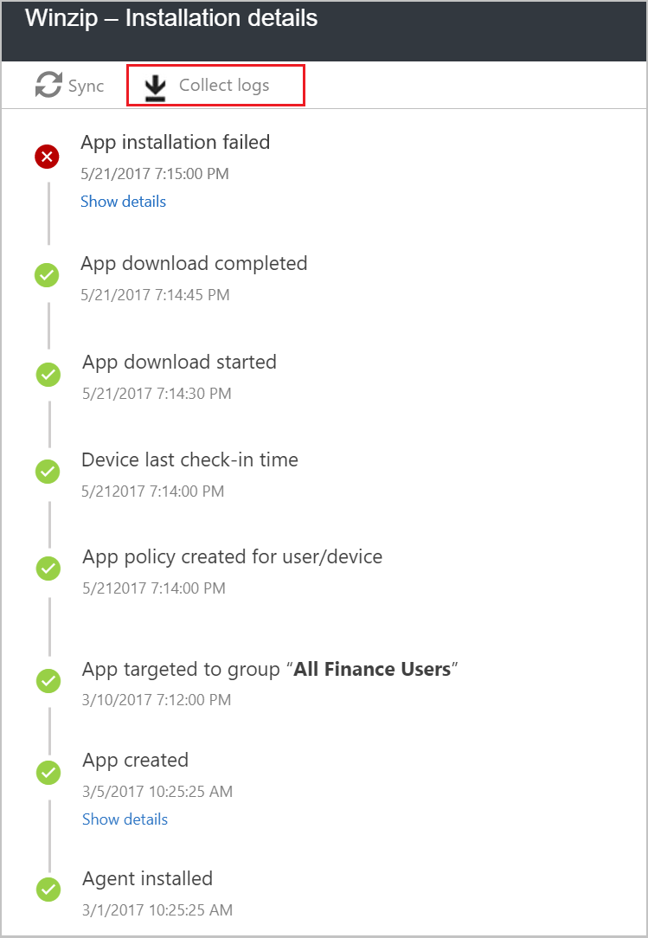
Microsoft Intune // Win32 App Log Collection
Intune Management Extension capability
On-demand collection
    Specify file paths (up to 25 files, 60MB max)
    Files are uploaded to Intune and stored
    Notified when collection is complete (two hours or less)
Working to integrate into Intune
For more info:
https://docs.microsoft.com/en-us/intune/troubleshoot-app-install

Slide 14
Windows Autopilot // Device lifecycle
The importance of the pre-created Azure AD device object
Multiple device objects with Azure AD and Hybrid Azure AD
Checking device health for grouping and targeting
End of life for a device
Notes:
2:00

Slide 15
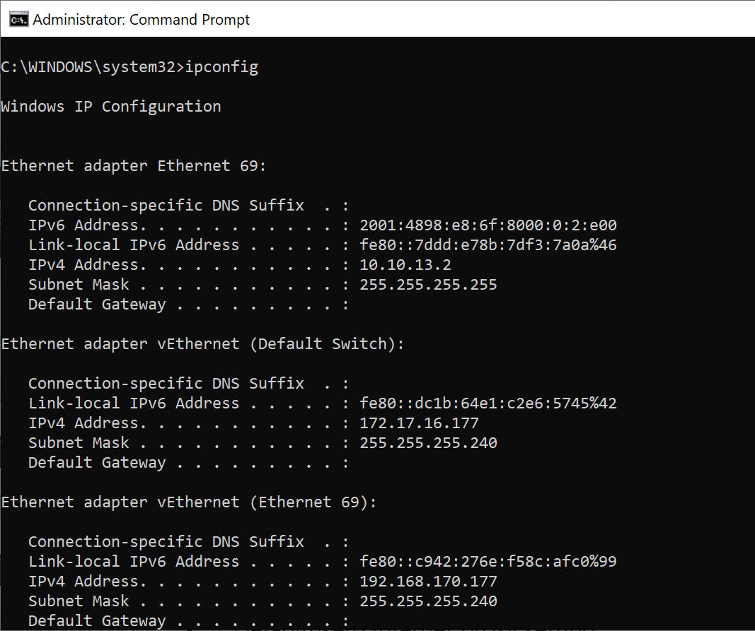
Windows Autopilot // Network troubleshooting
Validate the basics
    Firewall and ports
      https://docs.microsoft.com/en-us/windows/deployment/windows-autopilot/windows-autopilot-requirements-network
    Internet Access
      Shift + F10
      Ipconfig
      Open IE check if can access any webpage
    Proxy
      Defaultuser0 Internet proxy setting
      System Account proxy setting
      System proxy: netsh winhttp set proxy

Slide 16
Windows Autopilot // Azure AD Join failures
Symptoms:
    Various types of errors during the initial Azure AD Join process
Typical causes:
    Azure AD Join not enabled for the user
    Exceeded the number of allowed devices
    Custom branding not configured correctly*
    Scenario not enabled (white glove profile option)
    Third-party federation providers (e.g. Ping, Okta) not configured correctly

Slide 17
Windows Autopilot // Enrollment failures
Symptoms:
    Various types of errors during the initial Azure AD Join process or MDM enrollment
Typical causes:
    No license assigned
    Automatic MDM enrollment not configured correctly
    Device enrollment restrictions in place
    Conditional access restrictions
    Multiple MDM apps configured (with self-deploying mode or white glove)

Slide 18
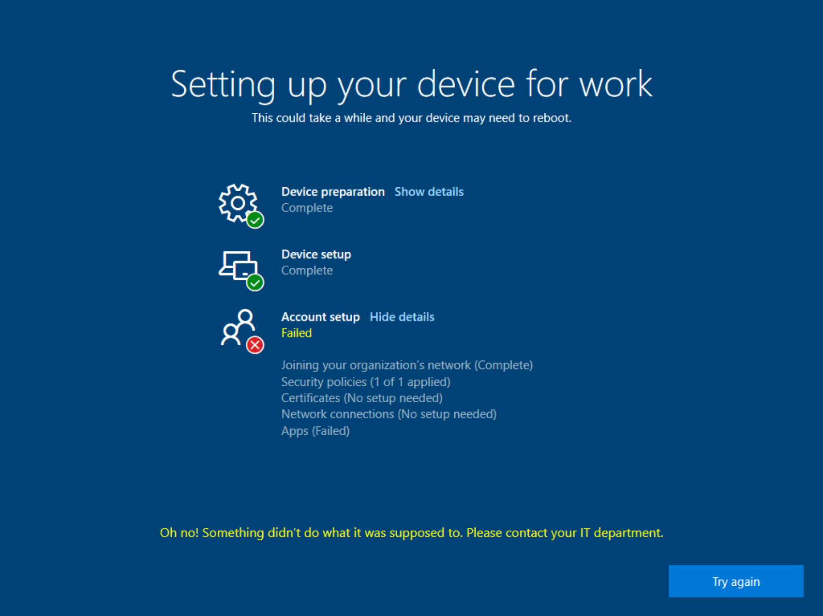
Windows Autopilot // Enrollment status page timeouts
Symptoms:
    ESP (when configured to block) times out
Typical causes:
    App install retries (MSIs)
    Hybrid Azure AD Join issues (not completing)
    App detection rule issues (Win32)
    BUG: Unable to install online store apps on Windows 10 1903
    Apps just need more time…

Slide 19
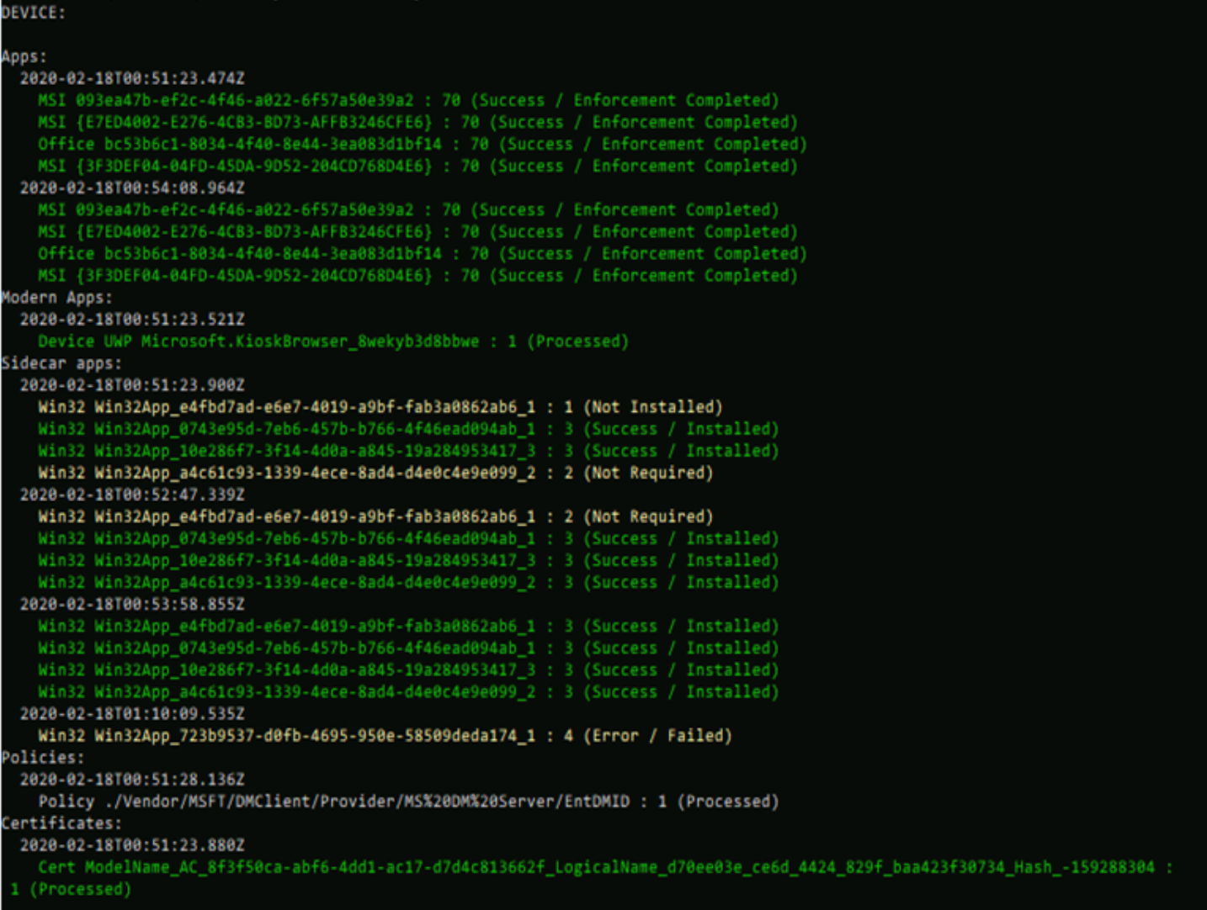
New ESP PowerShell script:
Set-ExecutionPolicy bypass
Install-Script Get-AutopilotESPStatus
Get-AutopilotESPStatus
Notes:
https://oofhours.com/2020/02/17/what-happened-during-windows-autopilot-esp-decode-it/

Slide 20
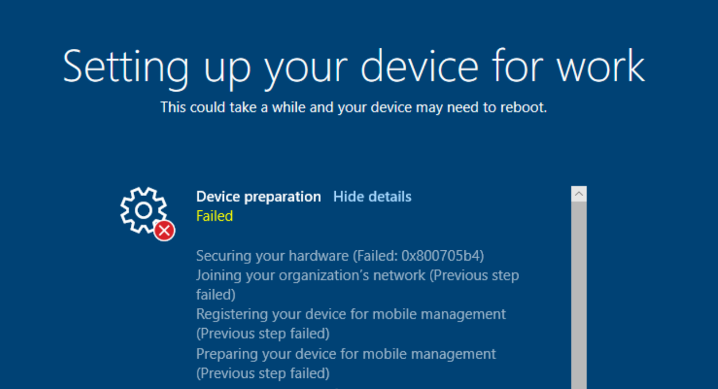
Windows Autopilot // TPM attestation errors
Symptoms:
    ESP (when configured to block) times out, even if you make the time longer
Typical causes:
    Using a virtual machine (virtual TPMs are not supported)
    Using TPM 1.2 (requires TPM 2.0)
    Using a device that needs a TPM firmware update
    Using a device that can’t obtain an EK cert (driver bug)
    Using an older TPM 2.0 device that doesn’t support EK certs
    Using Windows 10 1809 (problematic TPM attestation logic, can fail 20-50% of the time)
Recommendation:
    Only use new(-ish) hardware
    Only use Windows 10 1903 and above

Slide 21
Windows Autopilot // Acts like it’s not registered with Autopilot
Symptoms:
    All OOBE screens are displayed (expected screens are not skipped)
Typical cause:
  Autopilot profile not received by the client
  Client connected to network before the Autopilot profile was assigned (downloads a “not an Autopilot device” profile)
Recommendation:
    Make sure a profile is assigned
    For Windows 10 1803 and previous versions, reimage the device, reset the OS, or run sysprep /generalize to try again
    For Windows 10 1809 and above, reboot the device with “shutdown /r /t 0” inside OOBE command prompt (Shift-F10) to download a new Autopilot profile

Slide 22
Windows Autopilot // Hybrid Azure AD Join process does not complete
Symptoms:
    Device joins Active Directory but user ESP times out, can’t sync any user policies from Intune, single sign-on to AAD doesn’t work with any apps
Typical cause:
  Hybrid Azure AD Join background process isn’t completing (can take up to 30 minutes with AAD Connect when using password hash or passthrough authentication; typically faster with ADFS)
  Problems can be related to networking (can’t talk to AAD endpoints), configuration (devices aren’t being synced from AD to AAD due to misconfiguration, e.g. excluding the OU that the devices are in)
Recommendation:
    Check output of “DSREGCMD /STATUS” to see if the process has completed
    Check the AAD event log for any errors (e.g. network connectivity)
    Verify AAD Connect configuration
    See if the AD device has synced to AAD (there should be two devices in AAD for each Hybrid AADJ device)
    If using third-party federation providers (e.g. Ping, Okta) make sure they are configured properly

Slide 23
Windows AutoPilot // More troubleshooting info…
Troubleshooting Windows Autopilot, a reference
TPM Attestation: What can possibly go wrong?
Windows Autopilot oddities
Windows Autopilot docs
  Windows Autopilot - known issues

Slide 24
Windows AutoPilot // Best Practices
Use physical machines when required
  Self-deploying mode
  White glove (also requires Ethernet connection)
Use virtual machines otherwise to speed testing
  Useful to create checkpoints/snapshots to quickly roll back
  To avoid issues with cached Autopilot profiles, create checkpoint at the beginning of OOBE with no network adapter connected
  Be careful with Hybrid Azure AD Join, can be difficult to reset/rollback (if in doubt, unregister the machine, re-register it, make sure it’s again in the right AAD group and gets the right Autopilot profile, then try again)

Slide 25
Windows AutoPilot // Best Practices
Test one thing at a time
  First, try a manual Azure AD join (device not registered with Autopilot, not assigned an Autopilot profile) or a manual AD join with Hybrid Azure AD Join enabled/configured. If these don’t work, you can’t expect Autopilot to magically fix the issues.
  Once manual processes work, register the device with Autopilot, ensure it has a profile assigned, and try again to confirm the basic Autopilot flow.
  Add device configuration polices, or other simple configurations.
  Add apps.

Slide 26
Windows AutoPilot // Best Practices
Always gather failure details
  Grab a screen shot
  Capture logs with “mdmdiagnosticstool.exe -area Autopilot;TPM -cab c:\autopilot.cab” (support teams will ask for them)

Slide 27
Windows AutoPilot // Best Practices
Open support cases with the Intune support team
  Intune portal, “Help and Support” node
  Support included with Intune subscription
  If you have an existing CSS case with Windows, ask to have it transferred to Intune

Slide 28
BYOVPN

Slide 29
The End

