Slide 1
Managing in a
Software-as-a-Service World
Paul Thomsen, Paul.Thomsen@1E.com
Feb 19, 2016

Slide 2
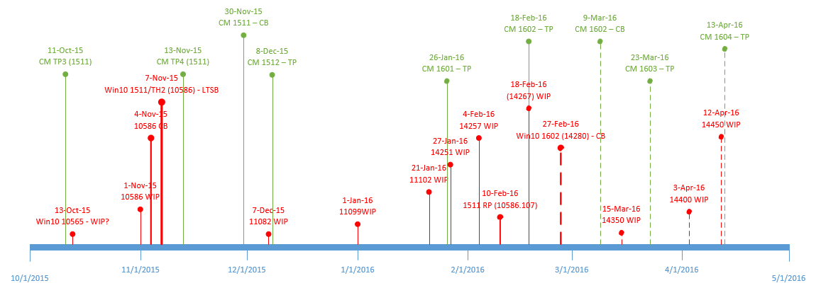
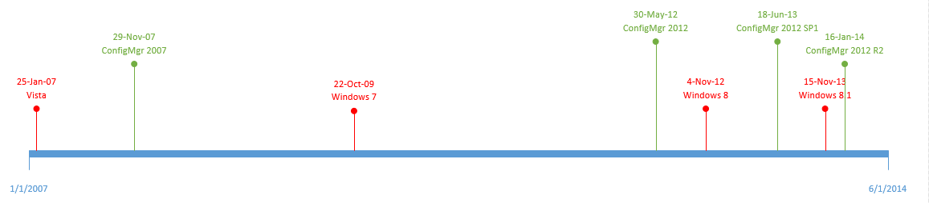
Old vs. New

Slide 3
Options
Windows
  Windows 7, 8, 8.1
  Windows 10 (YYMM)
    Windows Insider Program (Slow, Fast, Release Preview)
    Current Branch
    Current Branch for Business
    Long-term Servicing Branch
ConfigMgr
  ConfigMgr 2007, 2012, 2012 SP1, 2012 R2, 2012 R2+SP1/SP2, CUs
  Technical Preview
  Current Branch
Combinations

Slide 4
Implications
Participation in SaaS
  Understand what’s coming
  Ensure compatibility of your environment and internal solutions
  Provide feedback
  Update processes
Compatibility of third party solutions (vendors or community)
Take advantage of new features
  Windows
  ConfigMgr
But
  Lots of churn
  Update related solutions fast
  Lots of combinations to test
  More risk?
  You still have your day job

Slide 5
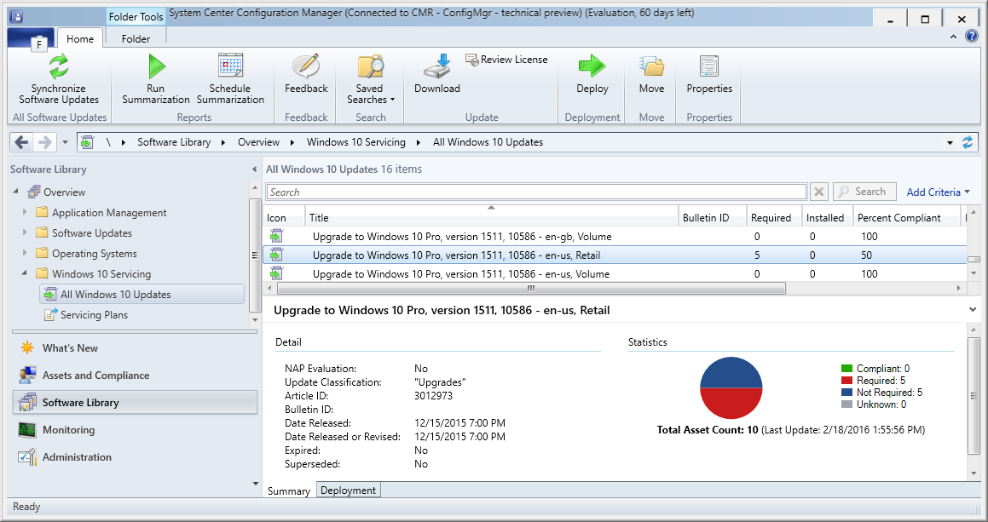
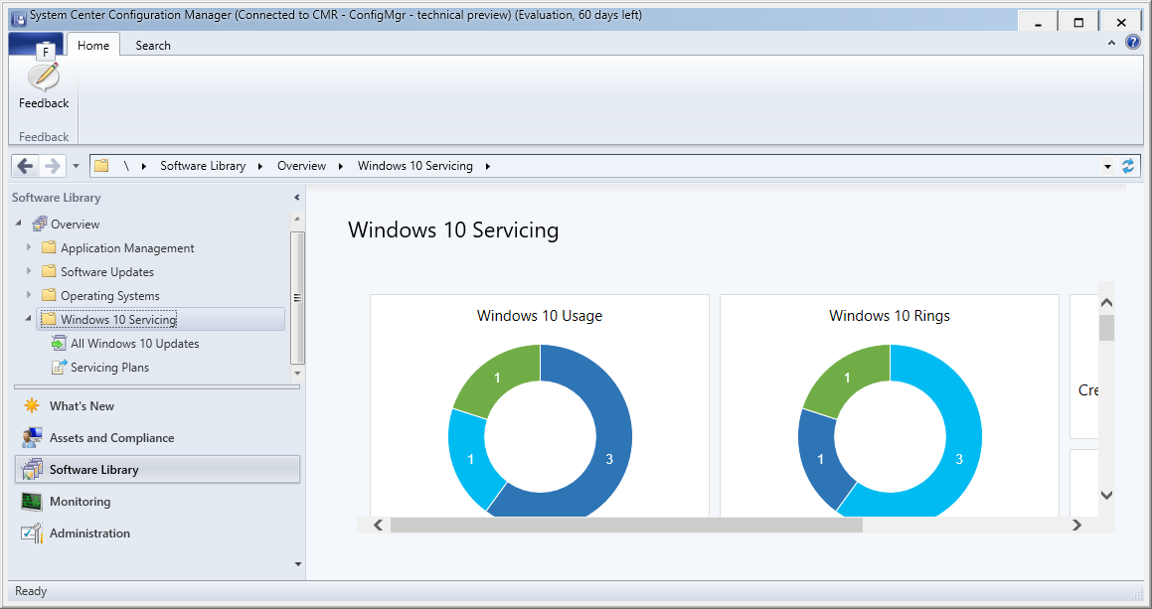
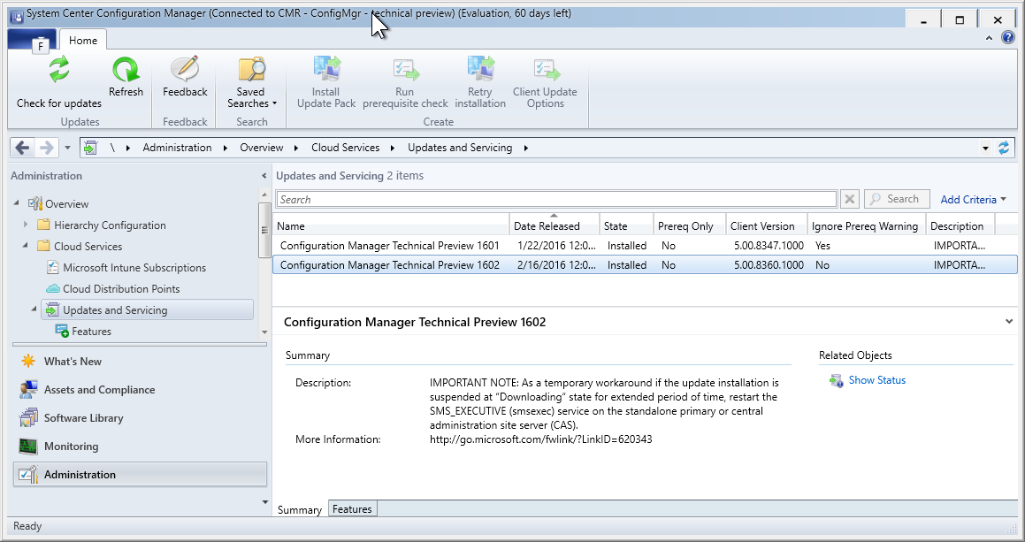
ConfigMgr
A strategy:
  ConfigMgr lab – technical previews
    10 clients
      Win7/8/8.1 if needed
      Current Branch for Business or Current Branch as needed
      WIP
    Internal and external solutions
    Upgrade fast – it’s easy and keeps your 60 day license current
  ConfigMgr production – current branch
    Current Branch for Business with a servicing plan
    Current Branch with a servicing plan
    LTSB with traditional upgrades/rebuilds
    WIP if you dare

Slide 6
Resources
Win10 release announcements: https://blogs.windows.com/windowsexperience/
ConfigMgr release announcements: http://blogs.technet.com/b/configurationmgr/
ConfigMgr unofficial announcements: @djammmer – David James
ConfigMgr update process: https://www.niallbrady.com/2016/02/18/system-center-configuration-manager-technical-preview-1602-is-now-available/
Features documentation: https://technet.microsoft.com/en-US/library/mt595861.aspx

